Slide 1
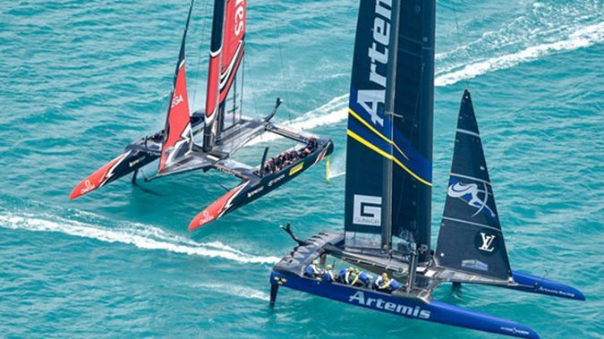
Physics of the America’s Cup

Slide 2
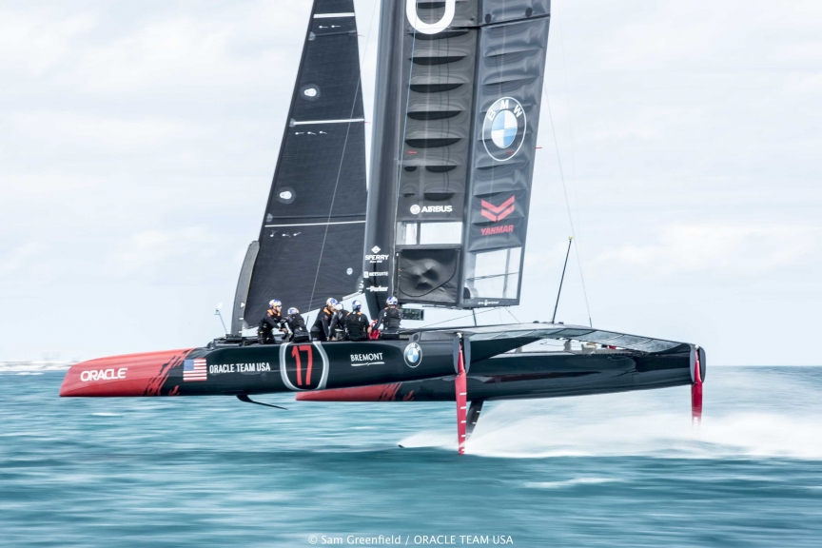
Statics – Balancing Forces
Newton’s 1st Law: If the forces are balanced, there is no change in motion.
In this case the lift forces upwards from the foils balance the downwards force of gravity on the boat (weight).
The lighter the boat, the less lift is required to ‘fly’ it!
Lift from hydrofoil
Weight

Slide 3
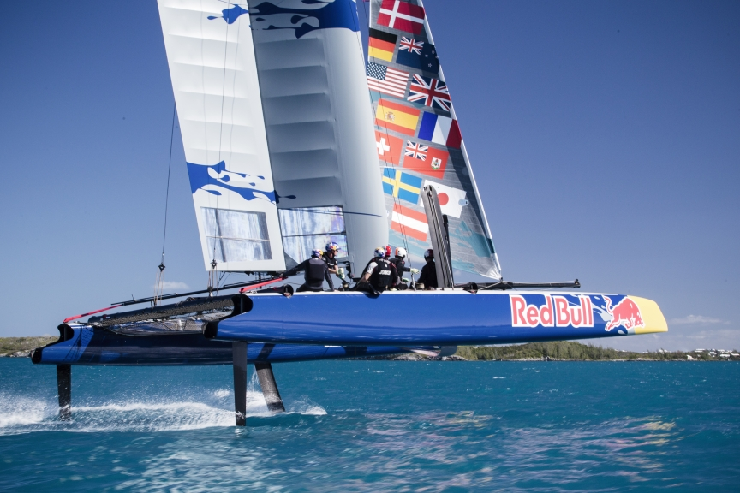
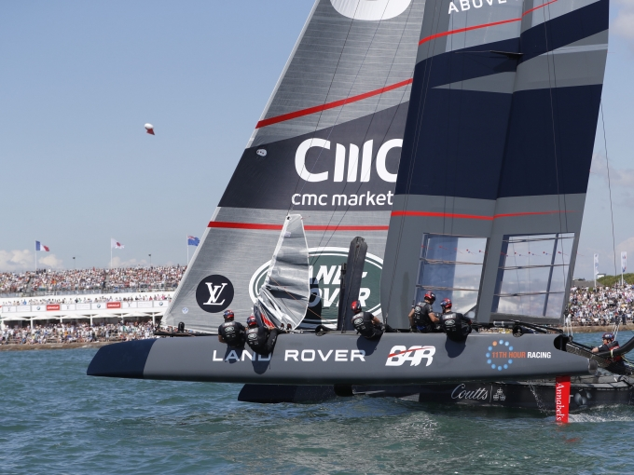
Why Bother Foiling?
Foiling mode
Displacement mode
Before foiling, the way catamarans reduced drag was to ‘fly a hull’.
A boat’s maximum speed is reached when the thrust from the sails (or engine) equals the frictional drag forces. Then, as the forces are balanced, the motion stays constant. (Newton’s 1st Law again!)
Fluid drag increases with speed – the faster the boat the greater the drag is.
If a boat is in the water, it must push aside a large volume of water. This dramatically increases the drag. Drag is proportional to the ‘wetted surface area’, so reduce the area touching the water and you reduce drag. Reduce drag, you go faster! Drag is also reduced by having a smooth surface – biofouling is very slow, which is why sailors always clean the bottom of a boat before a race.

Slide 4
How Do Foils Work?
Surprisingly, there is still some differences of opinion as to why the fluids flow at different speed. However, they definitely do….
LIFT
Faster fluid
DRAG
Slower fluid
The asymmetric curve of the foil causes the fluid on the top edge to flow faster and slower along the underside. This speed difference creates a pressure difference known as the Bernoulli Effect. This pressure difference causes the force we call LIFT.

Slide 5
How to Increase the Lift Force
Increase the relative speed of the fluid and the foil (i.e. sail faster!)
Increase the surface area of the foil (bigger foil)
Increase the curvature or asymmetry of the foil (more curvier foil)
Increase the angle of attack of the foil/fluid. (tilt foil upwards)
However, each one of these also increases the DRAG force. So the designers need to juggle the variables. It is hard for the designers to do ‘fair tests’ on these.

Slide 6
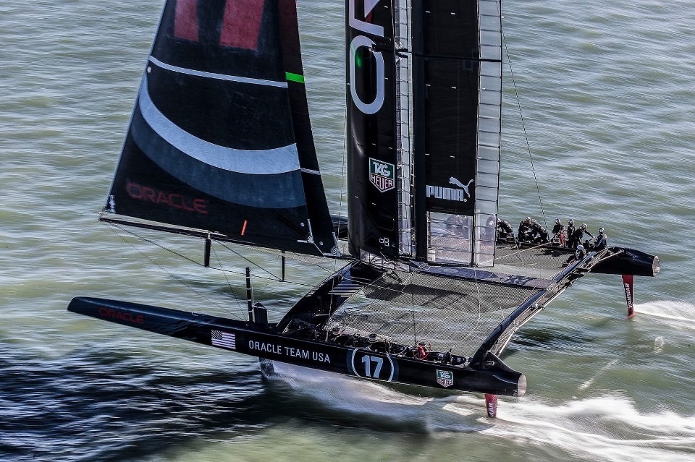
How Do Sails Make a Boat Go Upwind?
Only a small portion of the lift from the sails acts forwards, the rest acts to push the boat sideways! So how can a boat sail upwind?
Turns out that it the combination of the vertical surfaces in the water – the vertical parts of the foil and rudder.
Sideways lift from sails
The sails drive the boat both forwards and sideways (left) through the water at a slight angle to the foils – this is the angle of attack needed for the foils to generate lift to the right.
LIFT from foil and rudder
If the boat rides too high – it will slip sideways (as BAR did on day 1)
So, surprisingly, it is the vertical underwater bits that makes a boat go upwind, the sails just provide the speed necessary to make it work!

Slide 7
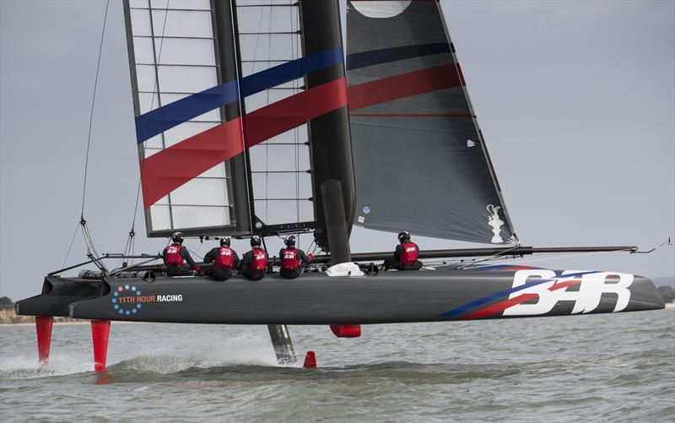
Stability 1 – Fore and Aft (Moments)
Principle of Moments
For the boat to remain stable, the turning effects of the forces (moments) about the PIVOT point must be equal.
Mts clockwise are:
Force from the sails
Force from the rudder elevators
Mts anticlockwise are:
Weight of the boat and crew.
Note that as the lift from the foils acts through the pivot point it has little effect.
Force from sails
The crew can change the pitch of the boat by a) changing the lift from the rudder elevators or moving themselves fore and aft slightly.
Lift from foils
Lift from rudder foils (elevators)
PIVOT
weight

Slide 8
Stability 2 – Lateral (Moments)
Oracle capsizing!
The capsize was caused by the moment caused by the lift from the sails (it was windy…) exceeding that created by the weight of the boat and crew.
Interestingly, the forces of buoyancy and lift from the foils had either little effect as they acted through the PIVOT point, or helped the sails to capsize it.
The crew can alter these forces by moving themselves outboard and/or easing the pressure of the sail.
Force of the sails
Lift from buoyancy and/or foils
weight
PIVOT

Slide 9
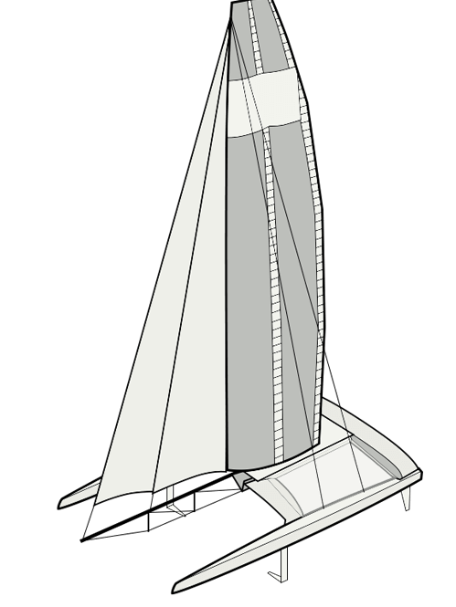
Why Don’t They Use Spinnakers Anymore?
Simply put – they sail too fast!
This is also the reason that they can sail up to 3 times faster than the wind!
Whenever you move relative to the air you create your own wind – try it on a bicycle!
TRUE WIND
HEADWIND created by boat speed
Have you ever wondered why boats rarely sail directly downwind? The headwind can completely counteract the true wind and you slow to a crawl.
Vector addition of the headwind and true wind = APPARENT WIND

