Slide 1
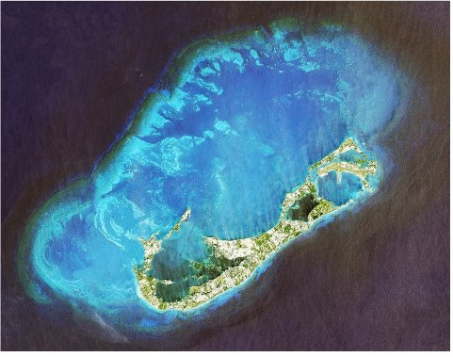
Ocean Science and Technology
Saltus Grammar School

Slide 2
Ideas for Projects
Underwater robotics project (very cool – possibly add a GoPro to the kit, explore caves/reefs and scare fish?!)
Glider work – interactive, students can assist in piloting (other programs have used students too)
Trips to Biostation and weather station
Reef survey (before/after a storm??)

Slide 3
ROV – Remotely Operated Vehicle

Slide 4
Basic ROV

Slide 5
Basic ROV

Slide 6
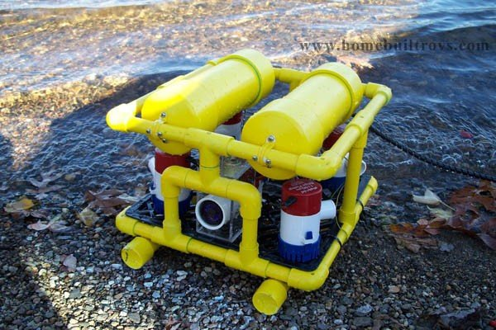
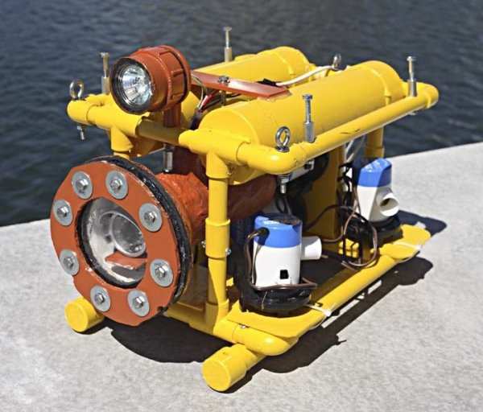
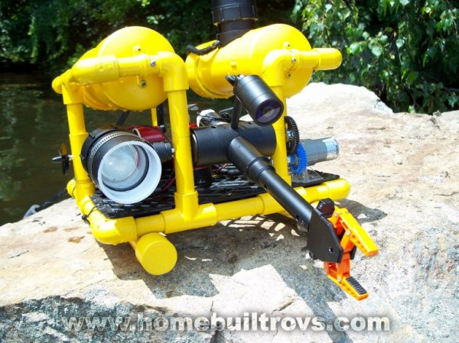
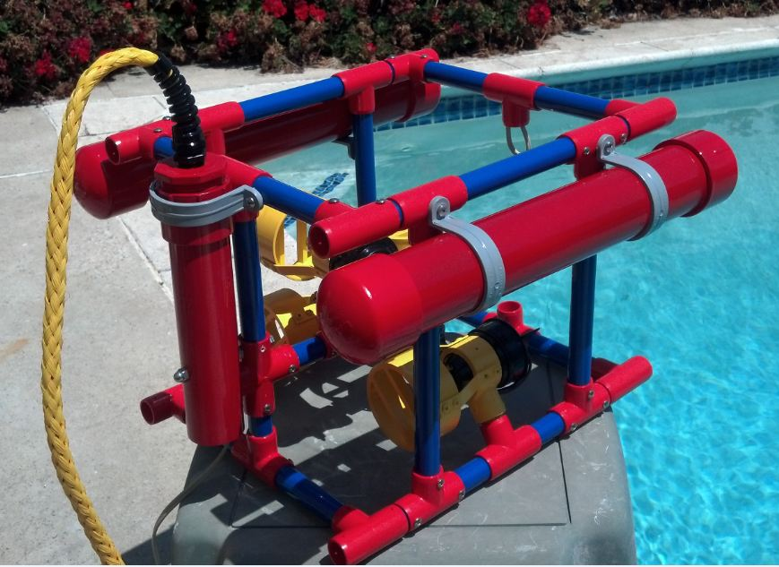

Slide 7
More sophisicated model

Slide 8
Gliders

Slide 9
Fish of Bermuda
The Bermuda time series?
Fuel from algae
Wave power project – data available from BWS – maybe make a working CETO model using buoys and bike pumps?
Weather forecasting for storms – when one comes
Balloon launch?
Tide gauge – or tidal patterns?
Homemade wind speed gauges?

Slide 10
Wind turbines – using small motors as generators perhaps – or possibly building a larger one that drives a car alternator? Carbon fibre??
Recording weather data (data loggers and spreadsheets)
Recording the angle of the Sun (for our solar arrays)
Projects on hurricanes, el nino, thermohaline circulation, gulf stream, convection, lightning etc…..

Slide 11
Plastics in the ocean – Blue Halo? – sampling after a storm?
Fish stocks (local and global?) and fish pots
Greaseballs on beaches
Cathodic corrosion
Biofouling and anti-fouling paints

