Slide 1
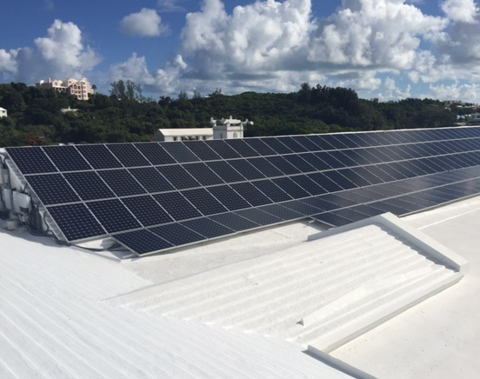
Energy Resources
Principles of Physics II

Slide 2
Electricity
Electricity is by far the most convenient method of using energy. It is easy to move around and there are a vast array of devices that use it.
Motors
Heaters
Lighting
Electronics

Slide 3
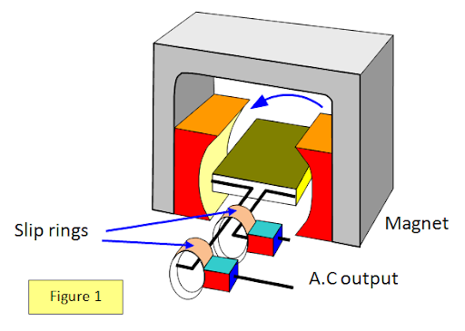
Electricity Generation
As we learned during the magnetism topic, all large-scale electricity is generated by electromagnetic induction. A coil of wire is rotated inside a magnetic field.
$$kinetic energy →electrical energy$$
It takes effort though, we cannot get something for nothing. This is the First Law of Thermodynamics we met in the Thermal Physics topic.

Slide 4
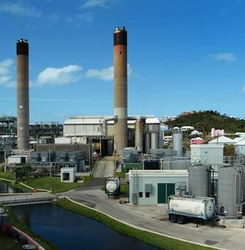
Fossil Fuels
At the moment, Bermuda generates electricity by burning diesel and heavy fuel oil in big engines.
The fuel mixes with the oxygen from the atmosphere and explodes, releasing heat energy.
This heat energy is converted into WORK. But not every efficiently – thanks to the Second Law of Thermodynamics.
This work is used to turn the generators.

Slide 5
What are Fossil Fuels?

Slide 6
Why are they so useful?
Current oil price
$220 per tonne
They are very energy dense. You get a lot of energy released per kilogram. You get more electricity generated per tonne of oil than you would by burning wood or ethanol.
BELCO produces around 100 MW of power. That is 100 MJ of energy per second. Assuming an efficiency of 42% that is equivalent to $N$ kg of oil per second.
Fuel | Energy Density (MJ/kg)
Ethanol | 30
Wood | 18
Coal | 30 ish
Oil (Diesel) | 45.6
Natural Gas | 55.6

Slide 7
Why are they so useful?
Current oil price
$220 per tonne
They are very energy dense. You get a lot of energy released per kilogram. You get more electricity generated per tonne of oil than you would by burning wood or ethanol.
BELCO produces around 100 MW of power. That is 100 MJ of energy per second. Assuming an efficiency of 42% that is equivalent to $N$ kg of oil per second.
$$Total energy required= \frac{100×{10}^{6}}{0.42}$$
$$Energy=238 \text{MJ}$$
$$N=5.2 \text{kg}\text{/}\text{s}$$
Fuel | Energy Density (MJ/kg)
Ethanol | 30
Wood | 18
Coal | 30 ish
Oil (Diesel) | 45.6
Natural Gas | 55.6

Slide 8
Why are they so useful?
Current oil price
$220 per tonne
They are very energy dense. You get a lot of energy released per kilogram. You get more electricity generated per tonne of oil than you would by burning wood or ethanol.
BELCO produces around 100 MW of power. That is 100 MJ of energy per second. Assuming an efficiency of 42% that is equivalent to $N$ kg of oil per second.
$$Total energy required= \frac{100×{10}^{6}}{0.42}$$
$$Energy=238 \text{MJ}$$
$$N=5.2 \text{kg}\text{/}\text{s}$$
$$Total=\left(365×24×60×60\right)N$$
$$Total=164 \text{thousand} \text{tonnes}$$
Fuel | Energy Density (MJ/kg)
Ethanol | 30
Wood | 18
Coal | 30 ish
Oil (Diesel) | 45.6
Natural Gas | 55.6

Slide 10
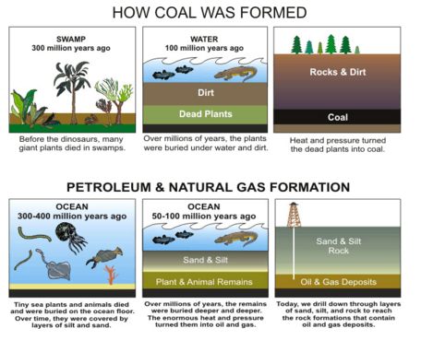
Where do they come from?
Long dead organisms. The energy stored from photosynthesis in the plant cells was preserved and crushed.
Takes millions of years…
These fuels are NON-RENEWABLE.
Once they have run out, we can never replace them.

Slide 11
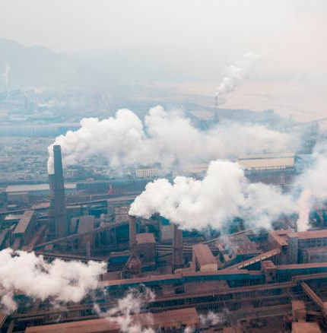
Also – they are dirty.
$SO_{2}$ contributes to acid rain
$CO_{2}$ contributes to global warming
Where does the $CO_{2}$ come from? Surely plants need it?
Yes… but this was carbon that was removed from the atmosphere millions of years and locked underground. Now it is being suddenly released.

Slide 12
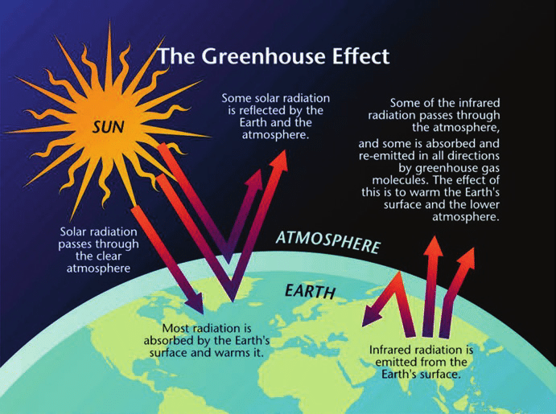
Greenhouse Effect
The Sun is HOT – short wavelength EM radiation is emitted (UV → Visible) that can penetrate the atmosphere. A percentage is reflected (albedo number)
The Greenhouse Effect is the name given to how the Earth’s temperature is moderated. The Moon has no atmosphere, so the daytime side is very hot and the nighttime very cold.
The Earth is warmed by the short wavelengths from the Sun. The Earth then re-radiates that heat back into space as IR radiation. Remember that heat goes from HOT → COLD. Clouds, water vapour and gases such as $CO_{2}$absorb and then re-radiate this IR radiation, BUT in all directions. Some is reflected back to Earth.
The Earth is WARM – longer wavelength EM radiation (IR) is emitted.

Slide 13
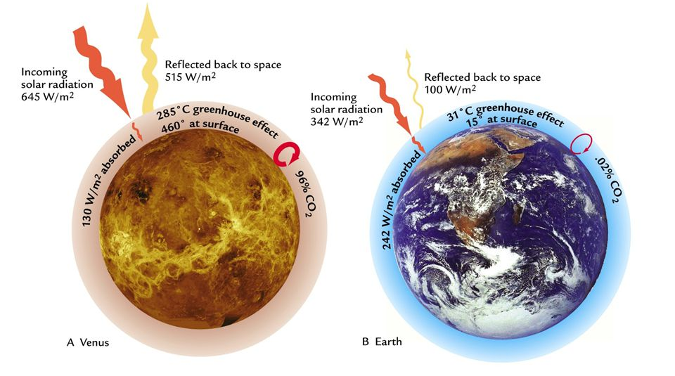
Venus is the hottest planet in the Solar System

Slide 14
So….
Fossil fuels WILL eventually run out.
They will get more expensive
They drive corruption
They are damaging our planet.
What options do we have?

Slide 15
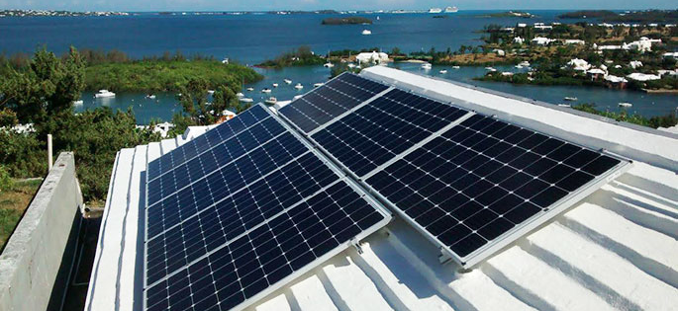
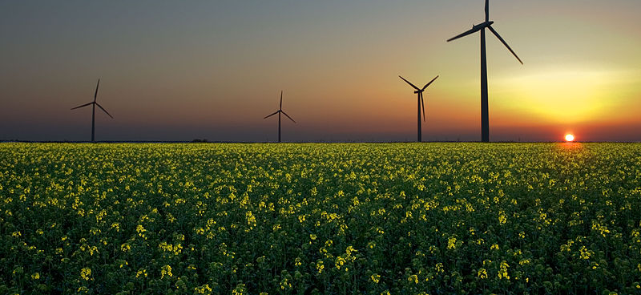
Alternative Energy Resources
Solar Power
Wind
Hydroelectric
Nuclear Power
Geothermal
Tidal Power
Wave Energy
Biofuels

Slide 16
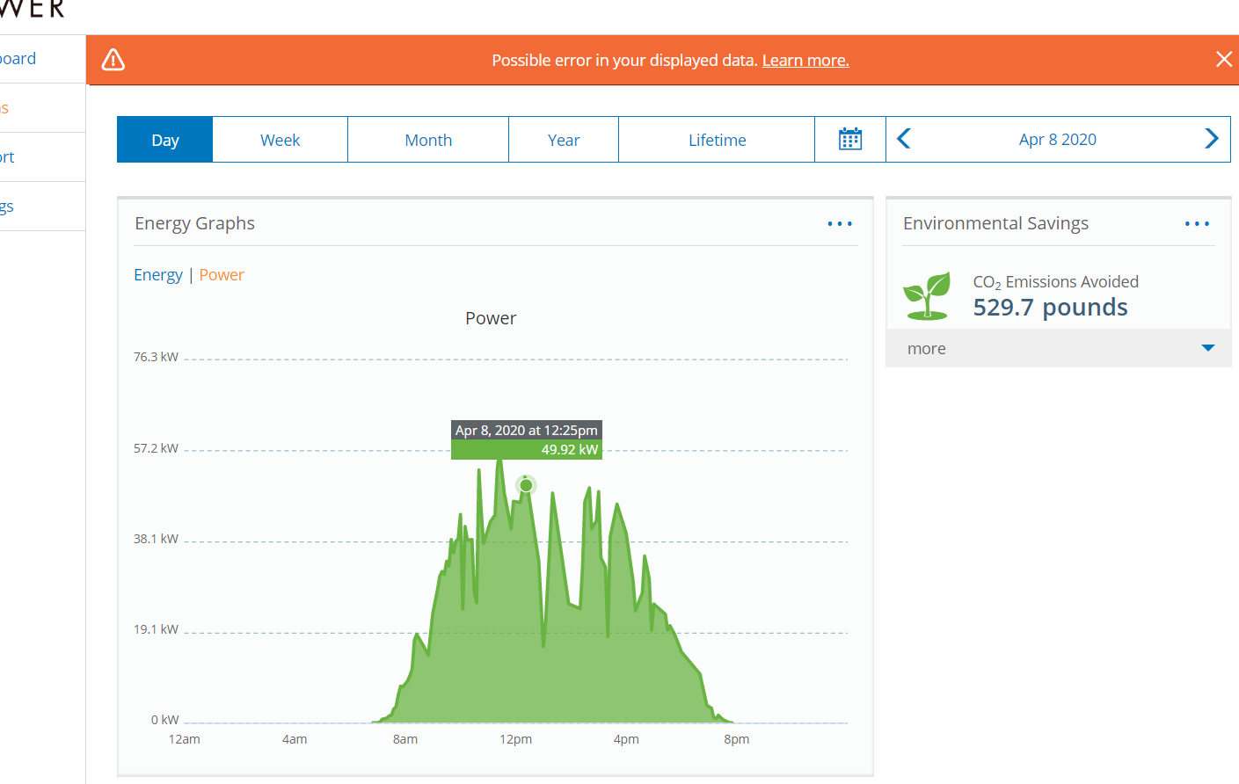
Saltus Solar Array(s)
Useful for businesses as the energy produced when building is occupied.
Solar array install in 2016.
Saved the school 299,564 kWh so far (9 April 2020)
So, at a cost 0f $0.43 per kWh, that is a saving of:

