Slide 1
Hurricanes

Slide 2
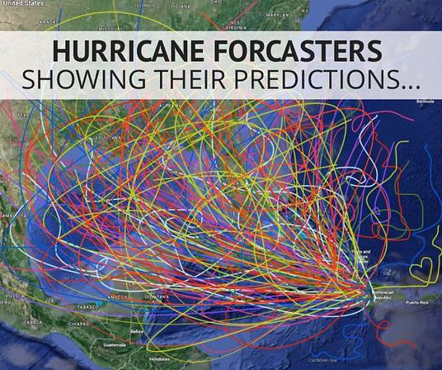

Slide 11
Factors that Increase Hurricanes
La Nina events – reduces upper level wind sheer in the North Atlantic
Warm ocean temperatures – increases the convection
Strong easterly winds south of the Sahara – initiates the disturbance that spawns into the hurricane
Other factors: North Atlantic Oscillation – where the high pressure exists in the North Atlantic. (causes unknown)

Slide 12
Factors that Decrease Hurricanes
El Nino events – increases upper level wind sheer in the North Atlantic
Cooler ocean temperatures – Decreases the convection
Cooler temperature south of the Sahara – decreases the initial disturbance

Slide 13
The Power of a Hurricane
$$ACE={10}^{−4}\sum{v^{2}}$$
The ACE of a season is calculated by summing the squares of the estimated maximum sustained velocity of every active tropical storm (wind speed 35 knots [65 km/h, 40 mph] or higher), at six-hour intervals. Since the calculation is sensitive to the starting point of the six-hour intervals, the convention is to use 00:00, 06:00, 12:00, and 18:00 UTC.

