Slide 1
Principles of Physics II
BERMUDA COLLEGE
3.2 – Ohm’s Law

Slide 2
Current depends on Voltage
The higher the voltage the faster the electrons are going to move. Remember that the voltage is what pushes/pulls the electrons around the circuit.
Georg Ohm was the first person to realise that they are proportional.
$$I ∝V$$
The constant of proportionality is known as the RESISTANCE
$$I=\frac{V}{R}$$

Slide 3
Ohm’s Law
This relationship is usually remembered as:
$$V=IR$$
What is resistance? It is easiest to visualize as the internal friction of a wire or component.

Slide 4
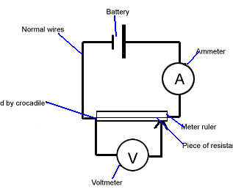
Mini-lab
Set up a circuit with a resistor, voltmeter and ammeter. Vary the voltage and measure the current.

Slide 5
DEMO: Light Bulbs
The resistance of a component is not always constant. An old-fashioned light bulb is a classic case. In this demonstration we are going to measure how the current in a bulb varies as a function of the voltage.

Slide 6
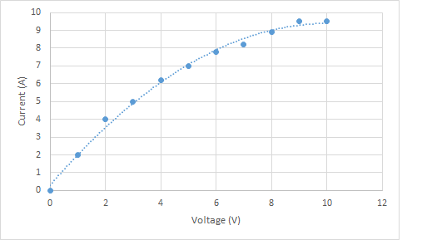
Results
The resistance of the filament increases as the current increases. This is because of the very high temperatures involved. As the filament gets hotter and hotter, its resistance increases.

Slide 7

EXAMPLES
A person notices a mild shock if the current through the thumb and index finger exceeds $80μ\text{A}\text{.}$ Compare the maximum possible voltage without a shock if the hands are dry and have a resistance of $4.0 ×{10}^{5}Ω$ and when they are wet and the resistance has dropped to $2,000Ω$.

