Slide 1
Principles of Physics II
BERMUDA COLLEGE
3.1 – Voltage, Charge and Current

Slide 2
Why Learn about Electricity?

Slide 3
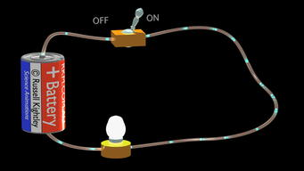
What do we need for a simple circuit?
Switch
Connecting wires
Power source (battery)
Component
(bulb)

Slide 4
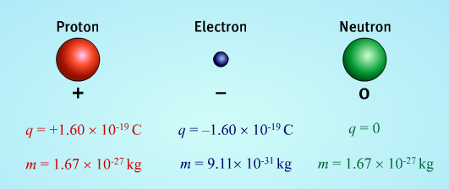
Charged Particles

Slide 5
What is moving in the circuit?

Slide 6
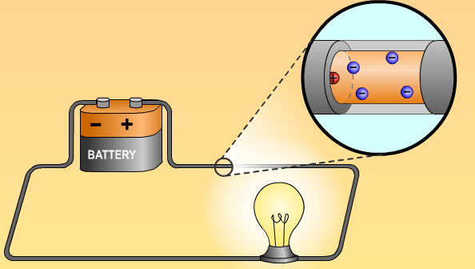
Current is the flow of charge
Let’s assume a 2.0 A current through the bulb. How many electrons are flowing through per second?
$$Q=It$$
$$Q=2.0 ×1=2 \text{C}$$
Each electron carries a charge of $1.6 ×{10}^{−19}$ C so,
$$N= \frac{2}{1.6 ×{10}^{−19}}$$
$$N=1.25 ×{10}^{19} \text{electrons}$$
$$I= \frac{Q}{t}$$

Slide 7
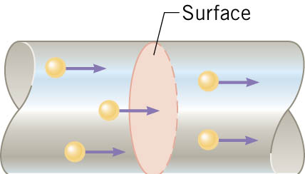
How fast are they moving?
Total charge in a section of wire =
$$Q=N×q$$
If there are n electrons per unit volume we get,
$$Q=n A∆x×q$$
Current is the rate of flow of charge,
$$I= \frac{Q}{t}=\frac{nA∆xq}{t}$$
$$I=nAqv$$

Slide 8
EXAMPLE
A copper wire of cross-sectional area $3.0 ×{10}^{−6}{\text{m}}^{2}$ carries a current of $10.0 \text{A}\text{.}$ Density of copper is $8.92 \text{g}\text{/}{\text{cm}}^{3}$ and its atomic mass is $63.5 \text{u}$.

Slide 9
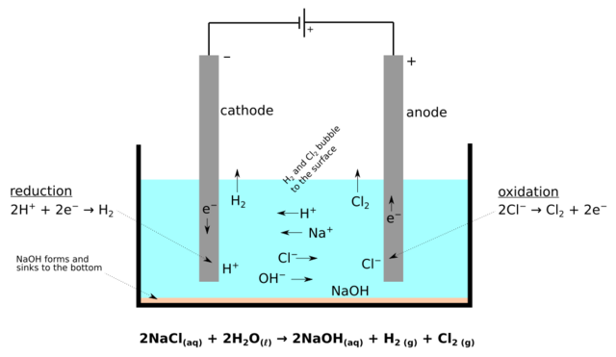
Is it only electrons that move?
In solid conductors, yes.
However, in ionic solutions, the positive and negative ions both can move. Going to leave this aspect to chemistry lectures though!

Slide 10
Cells and Batteries
Strictly speaking, a single unit of a battery is called a cell. However, this distinction gets blurry these days. Batteries and cells come in a wide variety of shapes and sizes, but all must have two terminals.

Slide 11
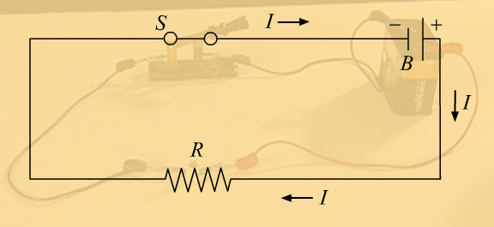
Circuit diagrams
We tend to simplify the circuits by drawing a diagram. Usually, the battery goes on the top or the left side of the diagram.

Slide 12
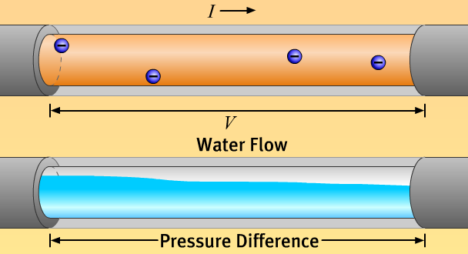
Water Model
An electric current is invisible, the electrons are far too small to see. It is often useful to imagine that the current is a flow of water along a pipe.
If the pipe has a blockage, no water flows. Just like a broken circuit.

Slide 13
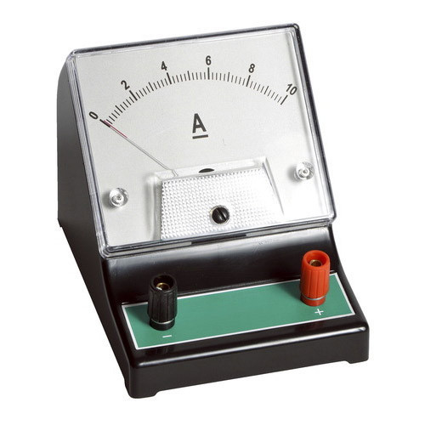
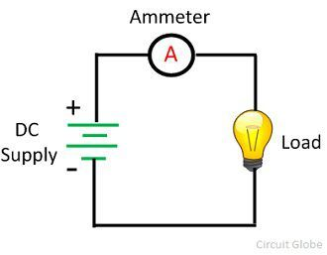
How can we measure the current?
We can insert a device called an AMMETER into the circuit. It is important to understand that the current must flow through the ammeter for it to get a reading.

Slide 14
Mini-lab
Build a circuit and measure the current at various places in the circuit using batteries and power supplies.

Slide 15
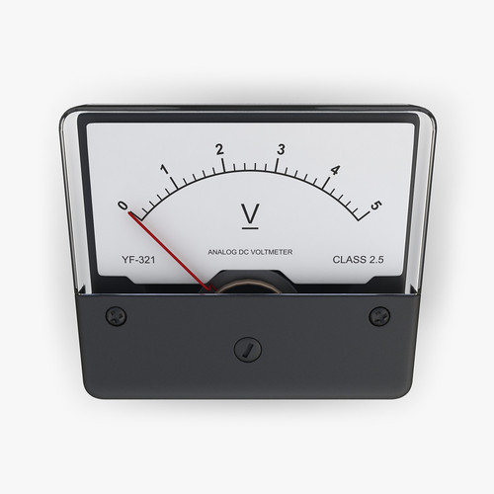
What is Voltage?
The voltage (potential difference) is what pushes and pulls the electrons around the circuit. Electrons are attracted to the positive terminal and repelled by the negative terminal. The higher the voltage, the faster the electrons will move.
Voltage is the energy supply to the circuit. It is measured using a VOLTMETER
$$V= \frac{E}{Q}$$

Slide 16
Mini-lab
Build a circuit and measure the voltage at various places in the circuit using batteries and power supplies.

Slide 17
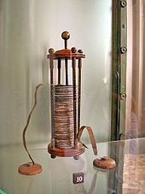
Voltage – other names
The voltage of a battery can be known be two other names:
Potential difference (but only by physics teachers). The name comes from the difference of the electrical potential energy at any two given points in the circuit.
Electromotive force, emf, $ℇ$. This is the voltage a perfect battery of generator. More about this later.
DEMO: making a simple battery

