Slide 1
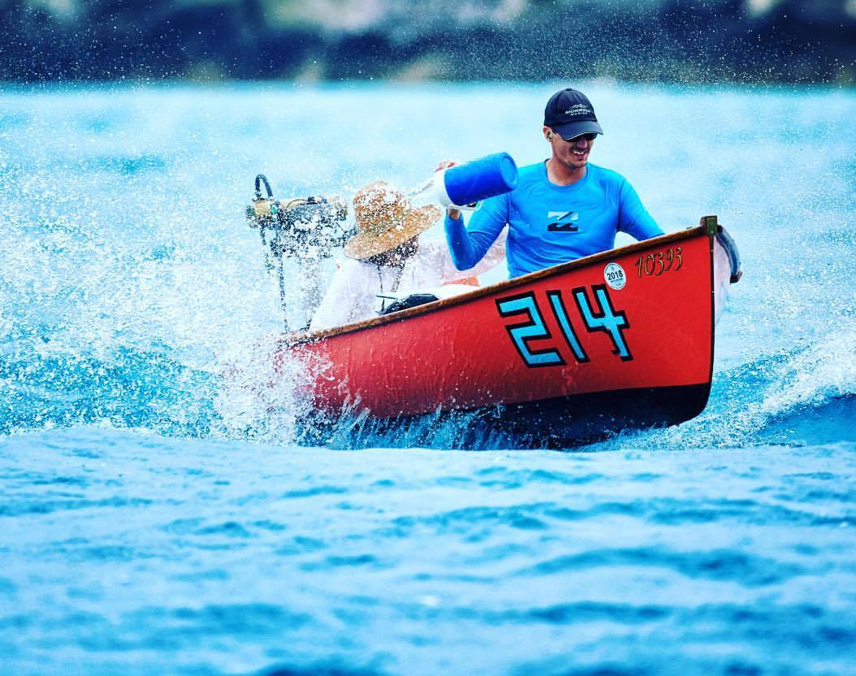
Principles of Physics II
BERMUDA COLLEGE
2.6 – The First Law of Thermodynamics

Slide 2
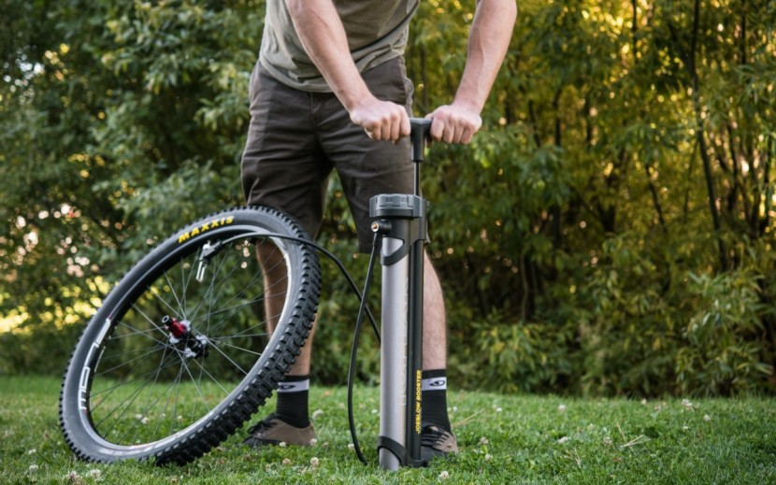
How to increase pressure?
There are THREE ways to increase the pressure of a gas:
Heat it
Squash it
Pump it

Slide 3
What is Thermodynamics?
The science of using heat to do work, or using work to move heat.

Slide 4
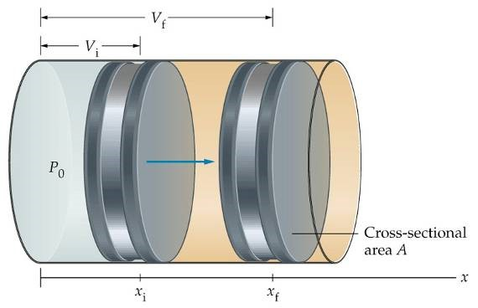
Gas Laws Recap
The primary method of work and heat exchange are through gases as they are compressible.
$$P_{1}V_{1}=P_{2}V_{2}$$
$$\frac{P_{1}}{T_{1}}=\frac{P_{2}}{T_{2}}$$
$$\frac{V_{1}}{T_{1}}=\frac{V_{2}}{T_{2}}$$
$$\frac{P_{1}V_{1}}{T_{1}}=\frac{P_{2}V_{2}}{T_{2}}$$

Slide 5
Gas Laws Recap
The primary method of work and heat exchange are through gases as they are compressible.
$$\frac{P_{1}V_{1}}{T_{1}}=\frac{P_{2}V_{2}}{T_{2}}$$
macroscopic
R = gas constant
n = number of moles
$$PV=nRT$$
microscopic
$$PV=NkT$$
k = Boltzmann’s constant
N = number of molecules

Slide 6
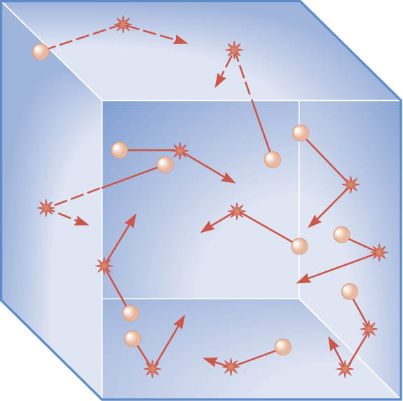
KINETIC THEORY - MICROSCOPIC
The pressure a gas exerts on the walls of a container is the result of molecules colliding with the walls.
If we assume collisions with the walls are elastic, each molecule of mass, m, exerts a force on the wall with a magnitude equal to the time rate of change of the molecule’s momentum.
After bouncing off the wall of the container a molecule may again collide with the container.
The time interval between the collisions with one wall is related to the molecule’s speed and distance between the walls.
Each collision changes the particle’s speed.
As a result, the atoms and molecules have different speeds.
Looking at gases more closely

Slide 7
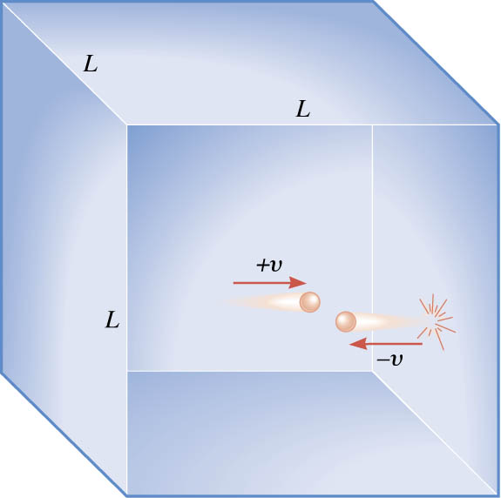
The pressure that a gas exerts is caused by the collisions of its molecules with the walls of the container.
The time t between collisions with the right wall is the round-trip distance 2L divided by the speed of the particle; that is,
$t= \frac{2L}{v}$
$$\sum{F=ma=m\frac{Δv}{Δt}}=\frac{Δ\left(mv\right)}{Δt}$$
$$\text{Average} \text{force} =\frac{\text{Final} \text{momentum}\text{−}\text{Initial} \text{momentum}}{\text{Time} \text{between} \text{successive} \text{collisions}}$$ $$F=\frac{\left(−mv\right)−\left(+mv\right)}{{2L}/v}=\frac{−mv^{2}}{L}$$

Slide 8
For a single molecule, the average force is:
$$F=\frac{mv^{2}}{L}$$
For N molecules, the average force is:
$$F=\left(\frac{N}{3}\right)\left(\frac{m\overline{v^{2}}}{L}\right)$$
root-mean-square
speed
Question: why the 1/3?
$$P=\frac{F}{A}=\frac{F}{L^{2}}=\left(\frac{N}{3}\right)\left(\frac{m\overline{v^{2}}}{L^{3}}\right)$$
volume

Slide 9
$$P=\left(\frac{N}{3}\right)\left(\frac{m\overline{v^{2}}}{V}\right)$$
Add the ½ into the brackets
$$PV=\frac{1}{3}N\left(mv_{rms}^{2}\right)=\frac{2}{3}N\left(\frac{1}{2}mv_{rms}^{2}\right)$$
$$NkT$$
$$\overline{\text{KE}}$$
From $PV=NkT$
$$\overline{\text{KE}}=\frac{1}{2}mv_{rms}^{2}=\frac{3}{2}kT$$
Question: What is the average speed of the air molecules in this lab?

Slide 10
Internal Energy - Macroscopic
This is the energy that all of the particles have – i.e. the energy of the gas due to the moving particles.
$$U= \sum{KE=N×\frac{3}{2}kT}$$
microscopic
$$U=\frac{3}{2}nRT= \frac{3}{2}PV$$
macroscopic

Slide 11
Internal Energy - Macroscopic
This is the energy that all of the particles have – i.e. the energy of the gas due to the moving particles.
Generally, we consider that the CHANGE in internal energy is proportional to the CHANGE in absolute temperature.
$$U=\frac{3}{2}NkT=\frac{3}{2}nRT= \frac{3}{2}PV$$
microscopic
macroscopic
$$PV=nRT$$
Bottom line: internal energy is proportional to absolute temperature

Slide 12
Example
What is the mean speed of an oxygen molecule in this lab? Do all of the molecules move at this speed?

Slide 13
Work
If the volume changes, then work has been done as a force has been applied over a distance
Work is the quantification of effort:
$$W=F∆x$$
As with fluids, the work on a gas is:
$$W=P∆V$$

Slide 14
How to increase the energy of the gas
There are TWO ways to increase the temperature of a FIXED mass of gas:
Heat it $Q>0$
Squash it $W>0$
First Law of Thermodynamics:
$$∆U=Q+W$$

Slide 15
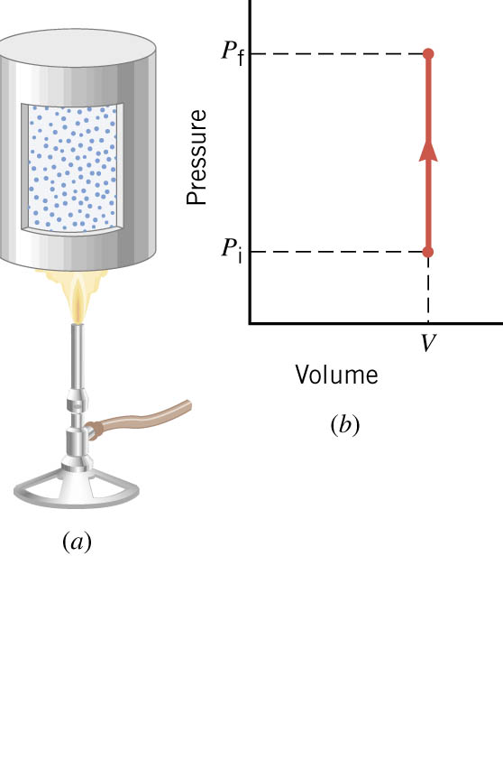
Higher pressure, heat has raised the temperature
$$PV=nRT$$
$$ΔU=Q+W=Q$$
$$W=0$$
No change in volume, so no work has been done

Slide 16
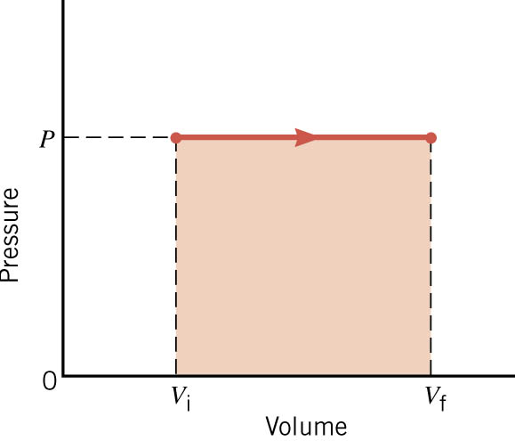
Heat has been converted into work – the piston moved
$$∆U=Q+W$$
Heat has gone in
Work has come out
Using the ideal gas law, we find that the temp has increased, so $∆U>0$
$$W=P∆V$$

Slide 17
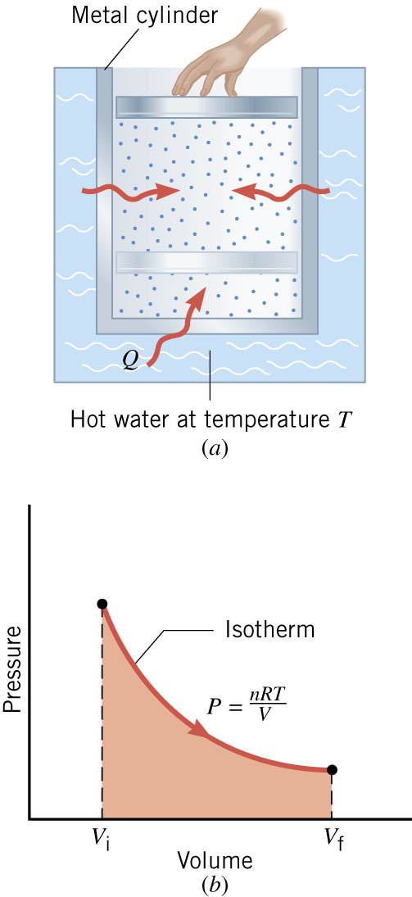
ISOTHERMAL EXPANSION
Using the ideal gas law, we find that the temp has stayed the same, so $∆U=0$
$$∆U=Q+W$$
Heat has gone in
Work has come out
In this case, ALL of the heat has been converted into work – the piston moved but the temperature did not increase.

Slide 18
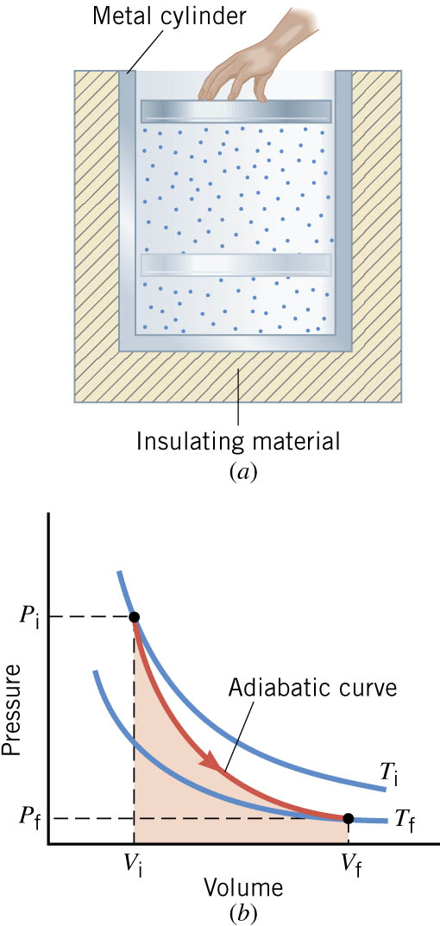
ADIABATIC EXPANSION
The insulation and/or rapid change prevent heat going in or out of the gas.
$$∆U=Q+W$$
NO heat has gone in
Work has come out
Reversing this is kind of fun!
Using the ideal gas law, we find that the temp has dropped, so $∆U<0$

Slide 19
Positive and Negative Work
In part a of figure, the system gains 1500J of heat and 2200J of work is done by the system on its surroundings.
In part b, the system also gains 1500J of heat, but 2200J of work is done on the system.
In each case, determine the change in internal energy of the system.
(a)
$$ΔU=Q+W$$ $$=\left(+1500 \text{J}\right)+\left(−2200 \text{J}\right)=−700 \text{J}$$
(b)
$$ΔU=Q+W$$ $$=\left(+1500 \text{J}\right)+\left(+2200 \text{J}\right)=+3700 \text{J}$$

Slide 20
Example
A car tyre (R13 205 60) containing 1.5 moles of gas has an internal volume 0.015 m³ and is initially at a pressure of 3.0 × 10⁵ Pa. Upon a sudden ‘blow-out’ (adiabatic process) the tyre pressure drops to that of the atmosphere at approximately 1.0 × 10⁵ Pa whilst the volume increases to 0.040 m³. Calculate the change in internal energy and work done on the gas.

Slide 21
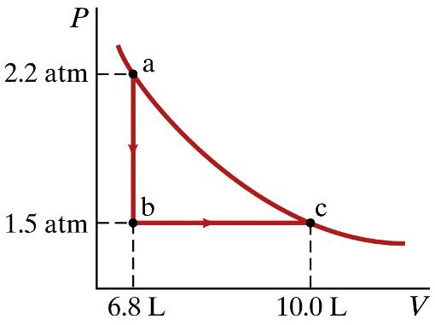
Example
Heat is allowed to flow out of an ideal gas at constant volume so that its pressure drops from 2.2 atm to 1.5 atm. Then the gas expands at constant pressure, from a volume of 6.8 L to 10.0 L, where the temperature reaches its original value. Assume that 1 atm = 1.01 × 10⁵ Pa. Calculate:
The total work done on the system in the process.
The change in internal energy of the gas.
The total heat flow into or out of the gas.

Slide 22
Example
Which process has
The greatest change in internal energy? $∆U$
Required the greatest amount of heat?

Slide 23
Example
0.25 mole of a gas is kept at 1150 K. The gas undergoes adiabatic expansion and cools, reaching a final temperature of 400 K. How much work was done on or by the gas?

