Slide 1
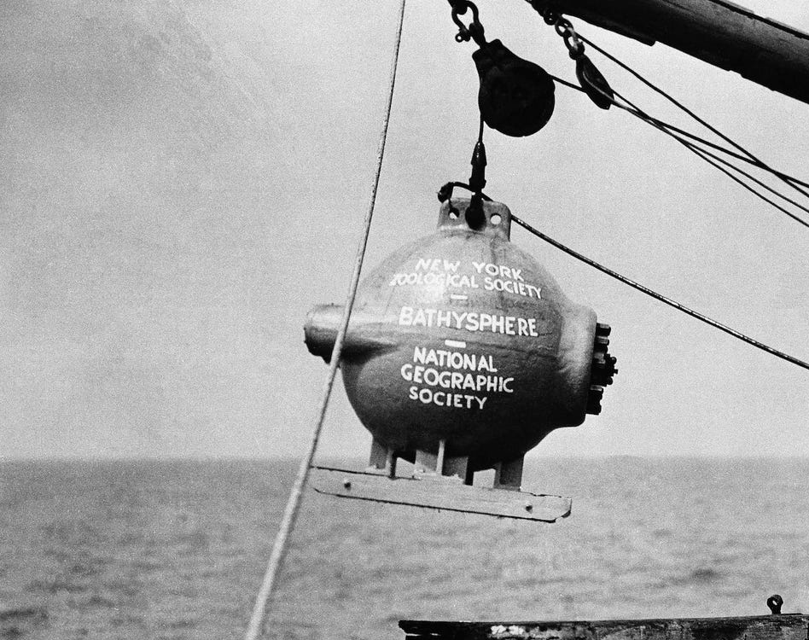
Principles of Physics II
BERMUDA COLLEGE
1.2 - Hydrostatic Pressure

Slide 2
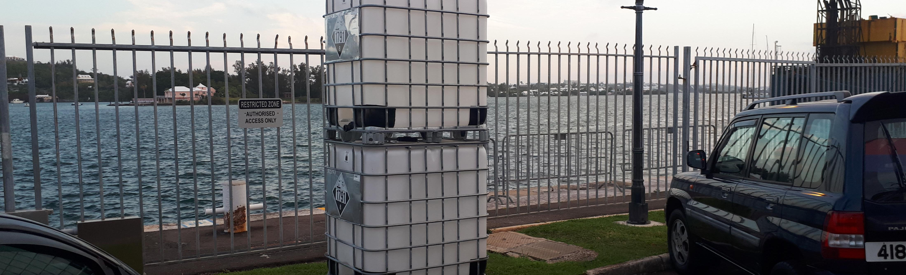
Numbers for water
$$ρ=1000 \text{kg}\text{/}{\text{m}}^{3}$$
$$ρ=1.0 \text{g}\text{/}{\text{c}\text{m}}^{3}$$
$$1.0 \text{kg}\text{ = }1.0 \text{litres}$$
$$1.0 {\text{m}}^{3} \text{= 1.0 }\text{tonne}$$
$$1.0 \text{ml}\text{ = 1.0 }\text{g}\text{ = 1.0 }{\text{cm}}^{3}$$

Slide 3
Cut to demo
Demo spouting can

Slide 5
Pressure is the force spread over an area.
$$P= \frac{F}{A}$$
This force is due to the weight of the water above.
$$P=\frac{mg}{A}$$
Mass of the water is density x volume
$$P= \frac{ρVg}{A}$$
Volume is the area x height
$$P= \frac{ρAhg}{A}$$
$$P= ρgh$$

Slide 6
Strictly Speaking….
Internet meme during COVID lockdown…
The total pressure is the pressure at the surface added to the pressure difference of the fluid.
$$P= P_{o}+ρg∆h$$

Slide 8
Fluid Height can be used to measure pressure - manometer
Manometer – simple pressure gauge
$$∆P= ρg∆h$$

Slide 9
Cut to demo
Demo a manometer

Slide 10
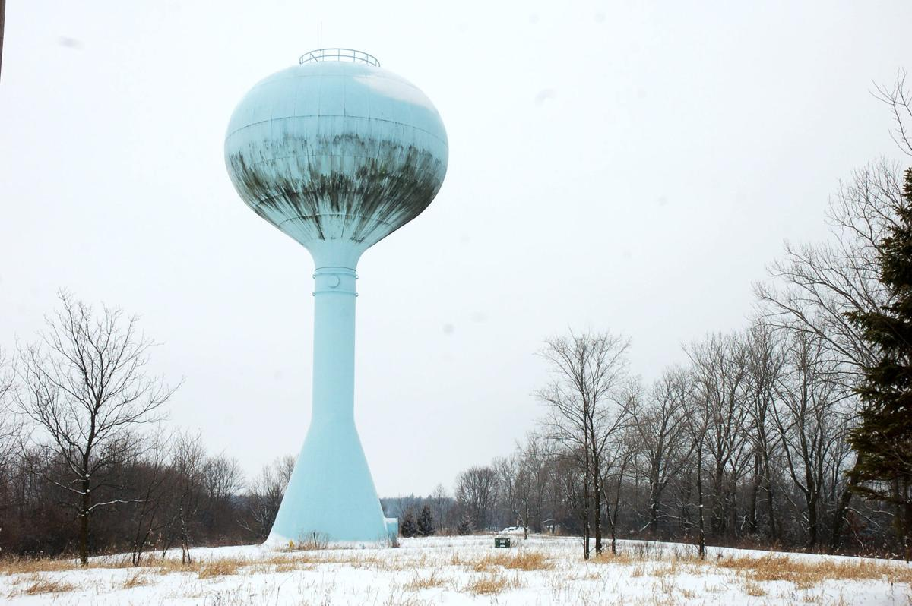
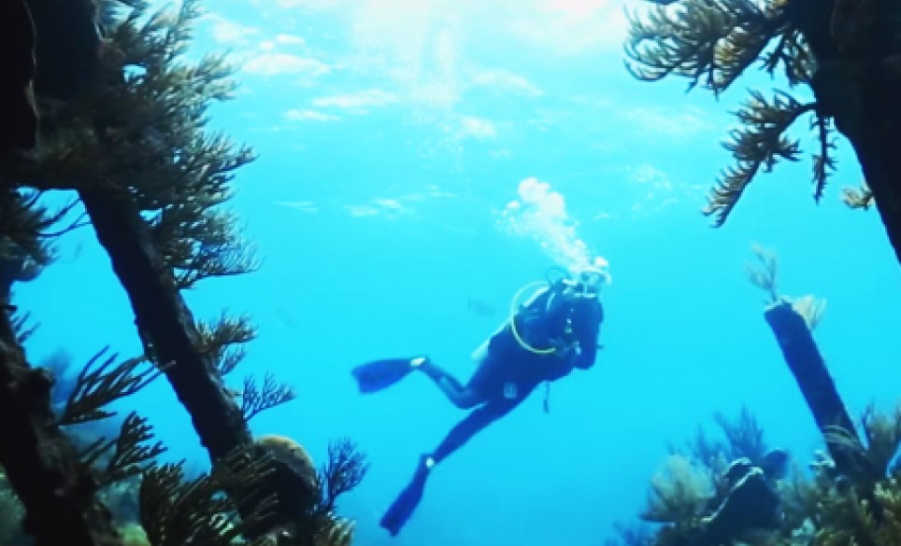

Slide 11
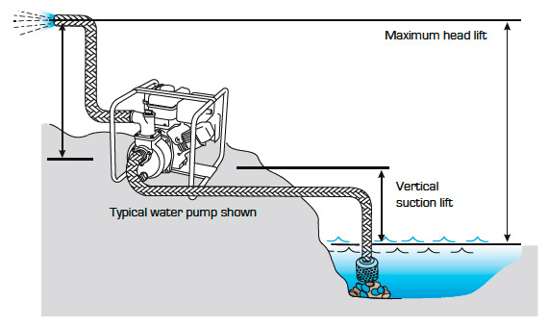
Pumps
$$height=when ∆P=pump pressure difference (usually P_{o})$$

Slide 12
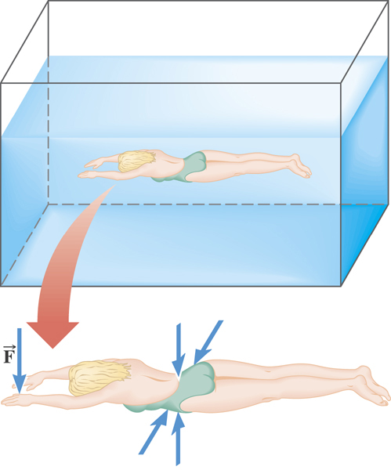
Pascal’s Principle
Pressure in a fluid is applied equally in all directions – consequence of Newton’s Third Law

Slide 13
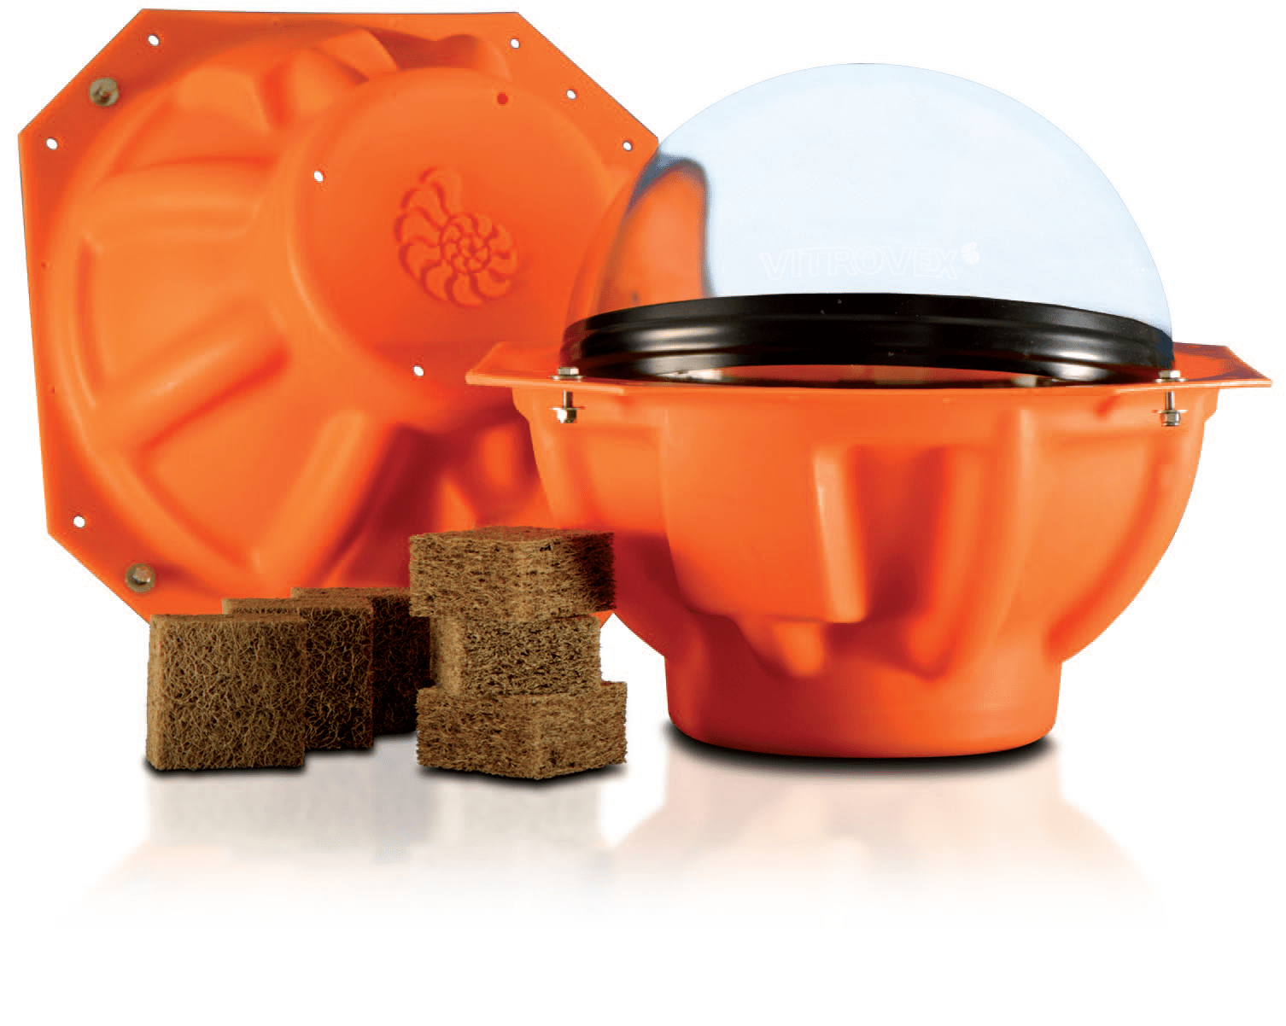
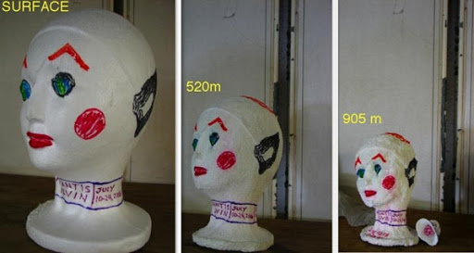
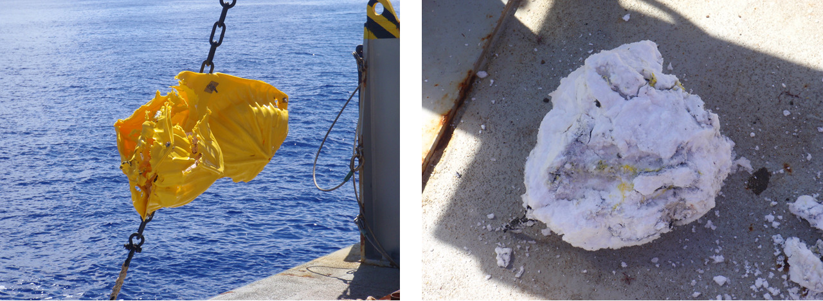
Effects of pressure in
the deep ocean
This was a glass sphere

Slide 14
Example 1
The Mariana trench is located in the floor of the Pacific Ocean at a depth of 11,000 m below sea level. The density of seawater is 1025 kg/m³. An underwater vehicle is sent down to explore. It has a circular window of radius 0.1 m. What force is applied to it if the pressure inside is 1 atmosphere?

Slide 15
Example 2
Watlington water supplies pressure at 1.90 x 10⁵ Pa at the meter which is located at road level. My house is on a hill and has a faucet to top up the tank 6.50 m above the road. What is the pressure of the water at the faucet? How high could I raise a hose pipe above the faucet and still have water coming out to clean my roof?

Slide 16
Example 3
The atmosphere does not suddenly end, but fades away gradually as you get higher. The Karman line is the official boundary of space at 100 km above sea level.
Why does the hydrostatic equation $ΔP= ρgh$ not work so well for the atmosphere?
Why do aircraft that fly at 10 km altitude need to be pressurized?
What is the value for standard atmospheric pressure and why does it vary?

