Slide 1
Rayleigh’s Criterion
How small or far can we see?

Slide 2
Resolving Objects
Our ability to distinguish objects depends on two variables:
Diameter of optical hole (aural too probably)
Wavelength of the viewing medium (light, sound, X-rays etc)
Diffraction due to the hole causes the image to blur.

Slide 3
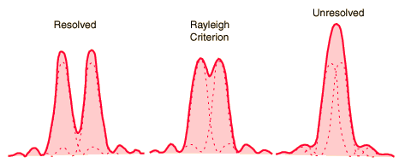
Diffraction Patterns
Limit of being able to distinguish between the two sources.
$$θ=1.22\frac{λ}{D}$$

Slide 4
This is a problem
To be able to distinguish two sources at a small angular distance we need to either:
Increase the diameter of the optical hole (make our telescope or camera aperture bigger)
OR
Reduce the wavelength of the light that we use.
Neither is always possible….

Slide 5
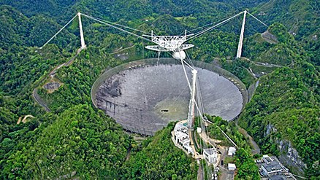
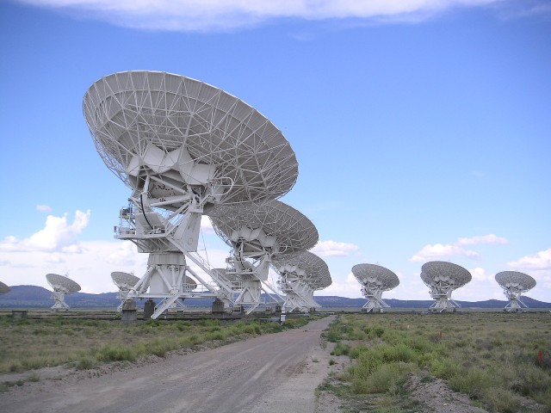
Radio Telescopes
The wavelength of radio waves is huge, so we need big dishes – or spread lots of dishes over a large area:
Arecibo – Puerto Rico
The Very Large Array – USA

Slide 6
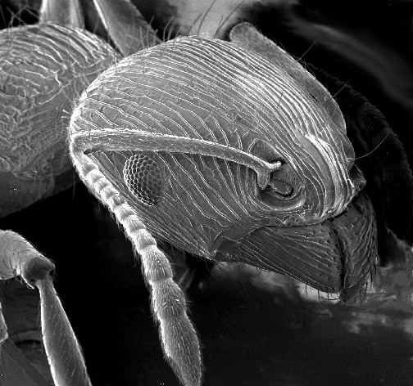
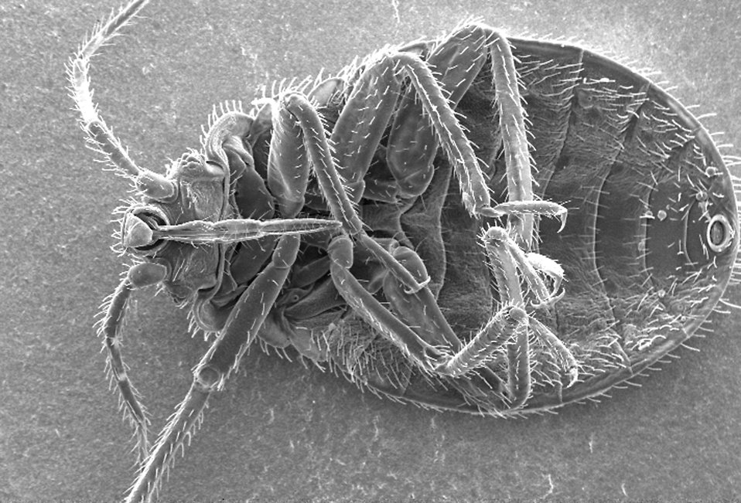
Electron microscopes
In this case, the wavelength is reduced to the smallest possible size:
$λ=3.9 ×{10}^{−15}$ m

Slide 7
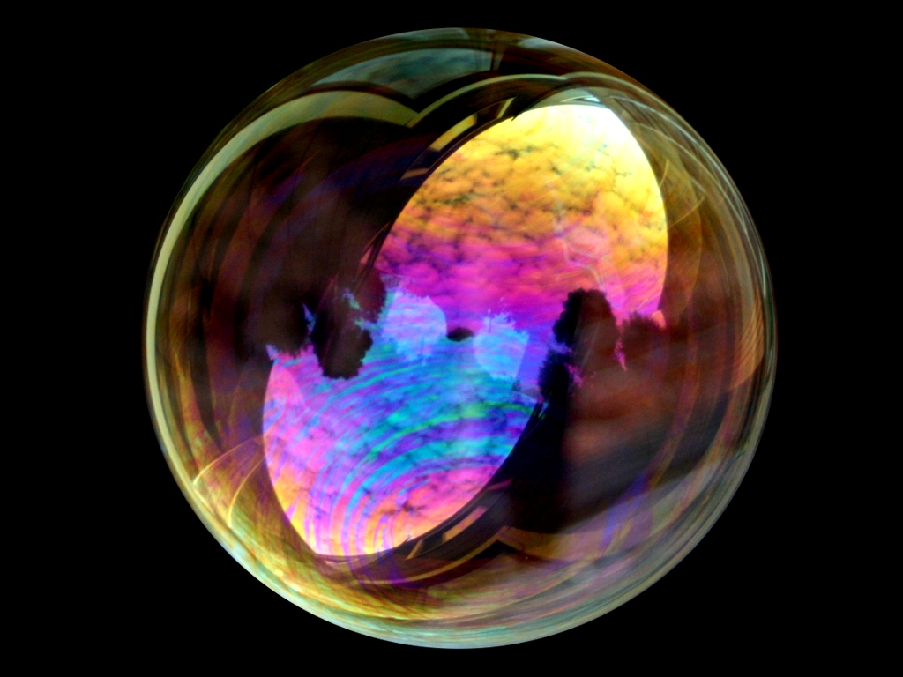
Ooooh – pretty

Slide 8
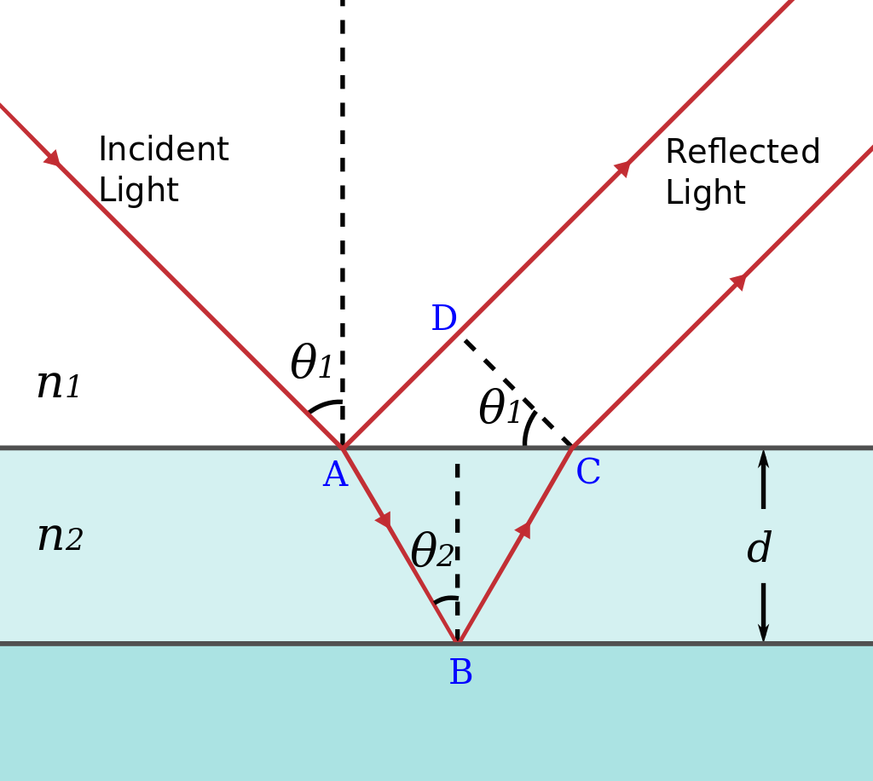
Reflection from high n to low n:
180° phase change
Reflection from low n to high n (TIR):
No phase change
$$λ_{n}=\frac{λ}{n}$$

Slide 9
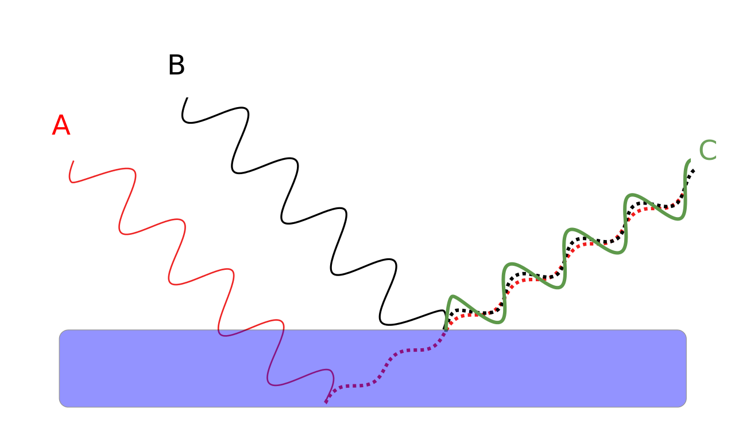
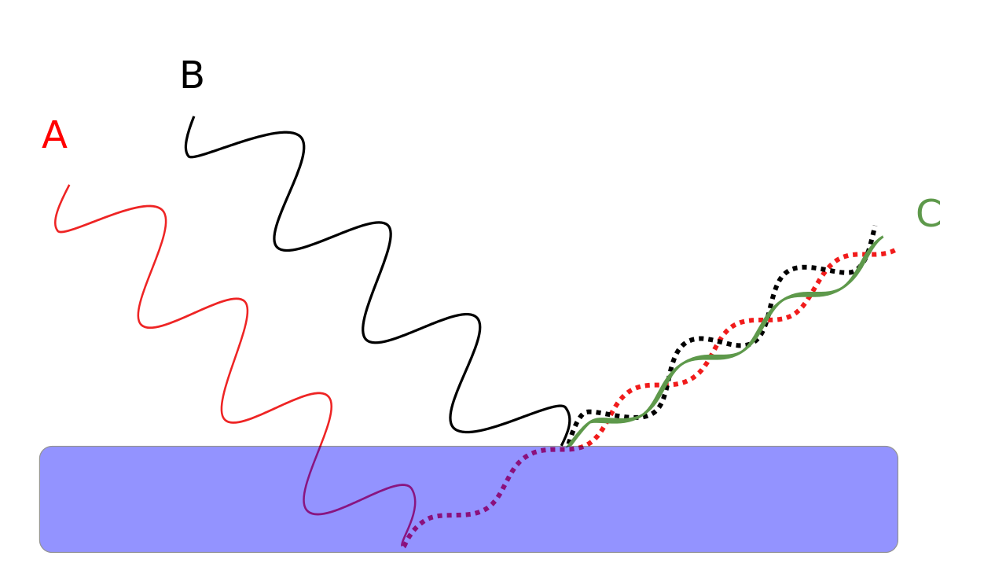
Constructive
Destructive
$$t=\frac{λ}{4n}$$
$$t=\frac{λ}{2n}$$

Slide 10
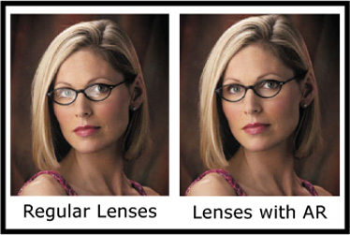
That extra $$$ on your specs….
If the mean wavelength of light is roughly 550 nm and the refractive index of the coating is 1.23, what is the mean thickness of the coating?

