Slide 1
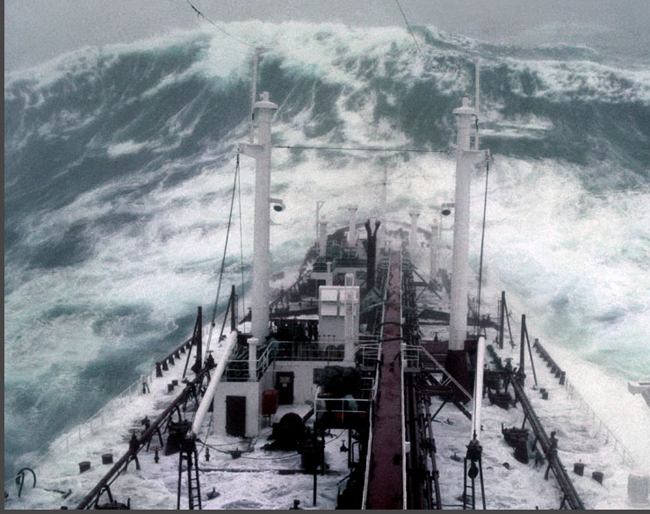
Oceanography
Saltus Grammar School
4.1 – Wave Motion

Slide 3
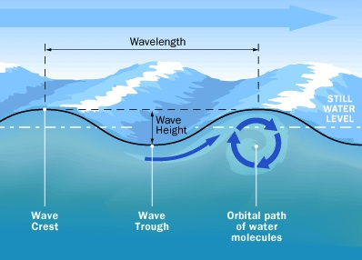
Ripples (capillary waves)
The simplest type of wave formed on the ocean’s surface is the ripple. The surface is disturbed (usually by the wind) and the some of the surface is pushed downwards, so some water is raised above the sea level. Surface tension between the water molecules pulls this back downwards, starting an oscillation. If it was wind that drove it, the top surface is forced sideways slightly, and a circular motion is started. If the wave height is low, then surface tension helps to keep the ripple as a sine wave. Ripples usually have a maximum height of 1.74 cm.
The water hardly moves forward at all, but the wave form does. Therefore energy is transmitted.

Slide 4
Wavelength, Period and Frequency
These terms are often confused.
Wavelength is the distance between two successive crests of a wave. It is a key variable. Symbol is either $λ$ or $L.$
Period is the time interval between two successive wave crests. On Horseshoe Bay, this may be a few seconds. For a long swell it can longer as the wave is long. The longest periods are the tides at 12 hours.
Frequency is a measure of how many waves occur in a given time interval. Usually this is seconds. But it maybe in minutes. For example a ship at sea may experience 12 waves per minute.

Slide 5
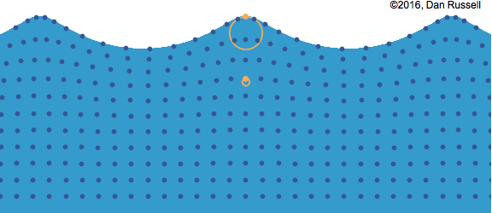
Wind-driven waves (Chop)
When the wave height starts to exceed a certain point, the wave moves away from the pure sine wave shape and takes on a more pointed shape. This is due to gravity dominating the restoring force that is trying to level out the water.
The rolling motion underwater extends down to half a wavelength. $λ/2$.
If $H>7λ$ then the top of the wave starts to break. The wave crest becomes foamy and white. White caps. Typically this occurs is the wind speed $>12 \text{kts}\text{.}$
Shallow water waves: $sea depth≤λ/2$
Deep water waves: $sea depth>λ/2$

Slide 6
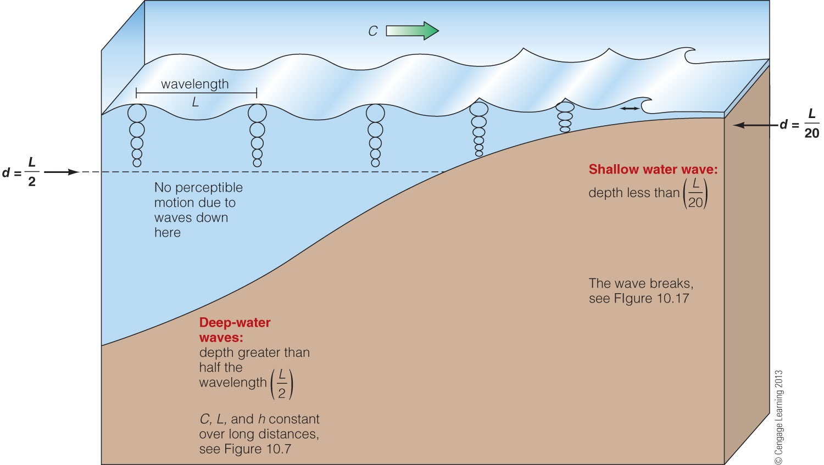
Wave behaviour is affected by depth
The energy transferred by a wave is a function of its height.
$$E∝H^{2}$$
The power would be the energy transferred per second.
Waves have far more effect than wind as the density of water is 1000 x more than air!

Slide 7
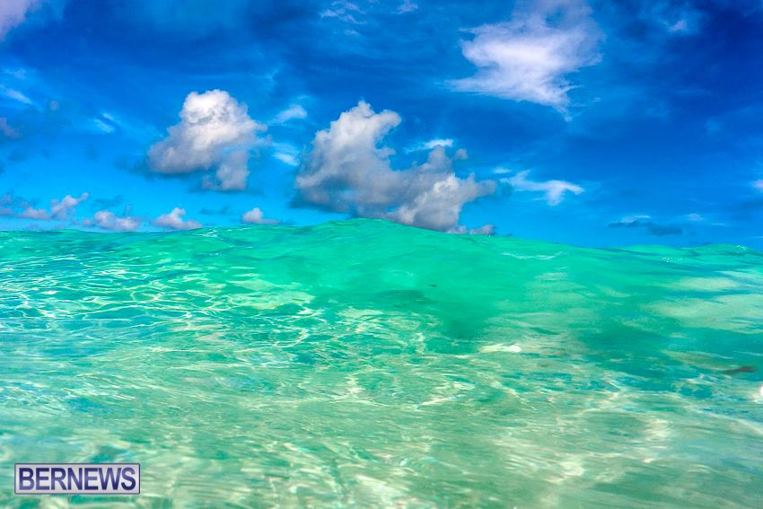
Speed of Waves (celerity)
The speed of a wave is dependent on TWO variables.
$$wavelength and depth$$
Shallow water waves:
The seabed suppresses some of the circular motion under the surface and slows it down due to friction.
$$v=\sqrt{gd}$$
The wave’s frequency is constant. Because the shallower water slows the wave, it also reduces the wavelength. The same amount of water is moving though, so the height builds. We see this when waves move up a beach.
Deep water waves:
The speed of the wave is determined predominately by its wavelength (and hence period)
$$v=1.25 \sqrt{λ}$$
This is the origin of ocean swell. The long wavelength waves travel faster away from the storm than the shorter waves. Without the high winds that created them, they tend to ease off to a more sinusoidal shape.
Intermediate waves – the distinction between deep water waves and shallow water waves is not sudden. They change gradually into one another…..

Slide 8
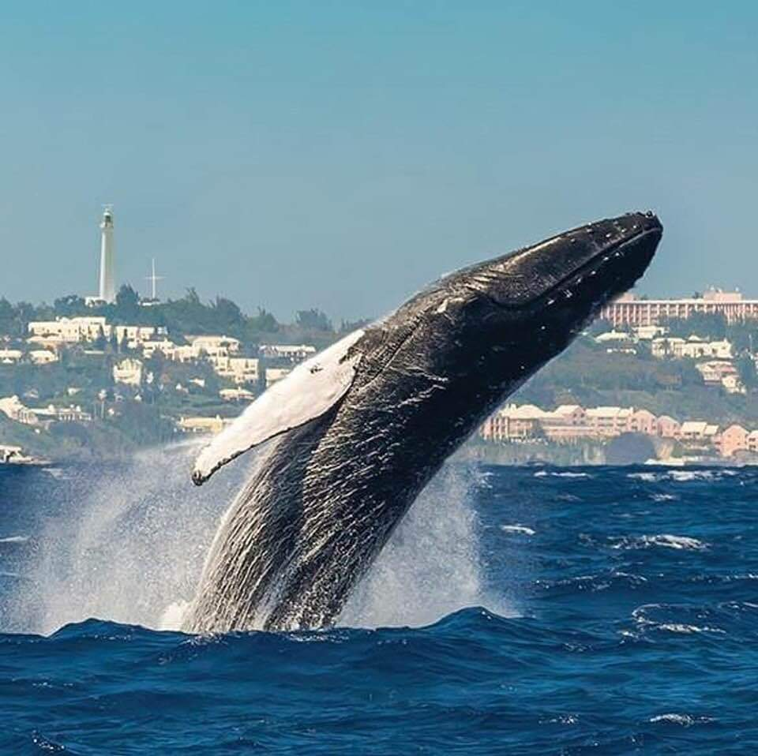
Waves in Bermuda
Humpback Whale breaching – note the white caps and more angular shape of the waves. Wind $>15−20 \text{kts}$
Dinghies in Granaway – hardly any wind, barely even ripples on the water

Slide 9
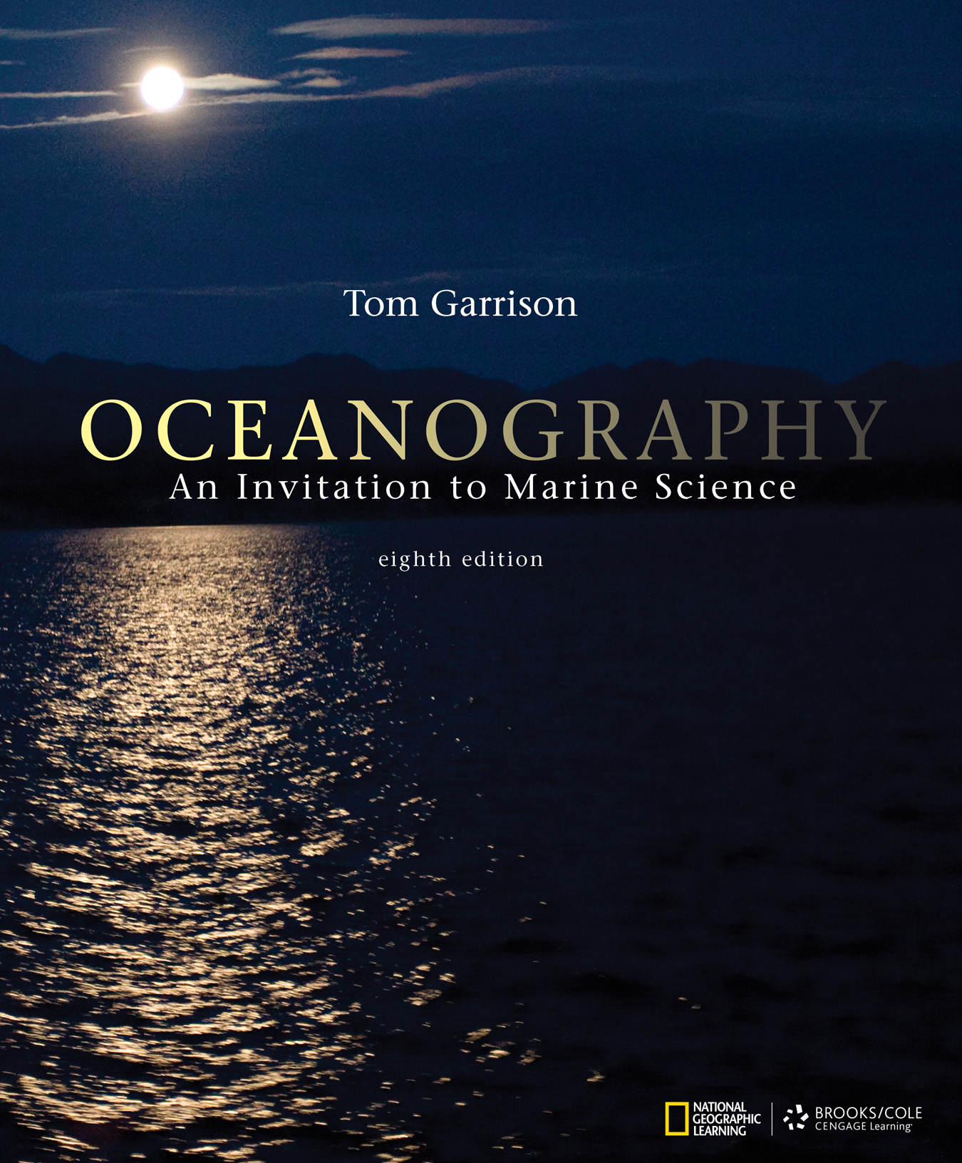
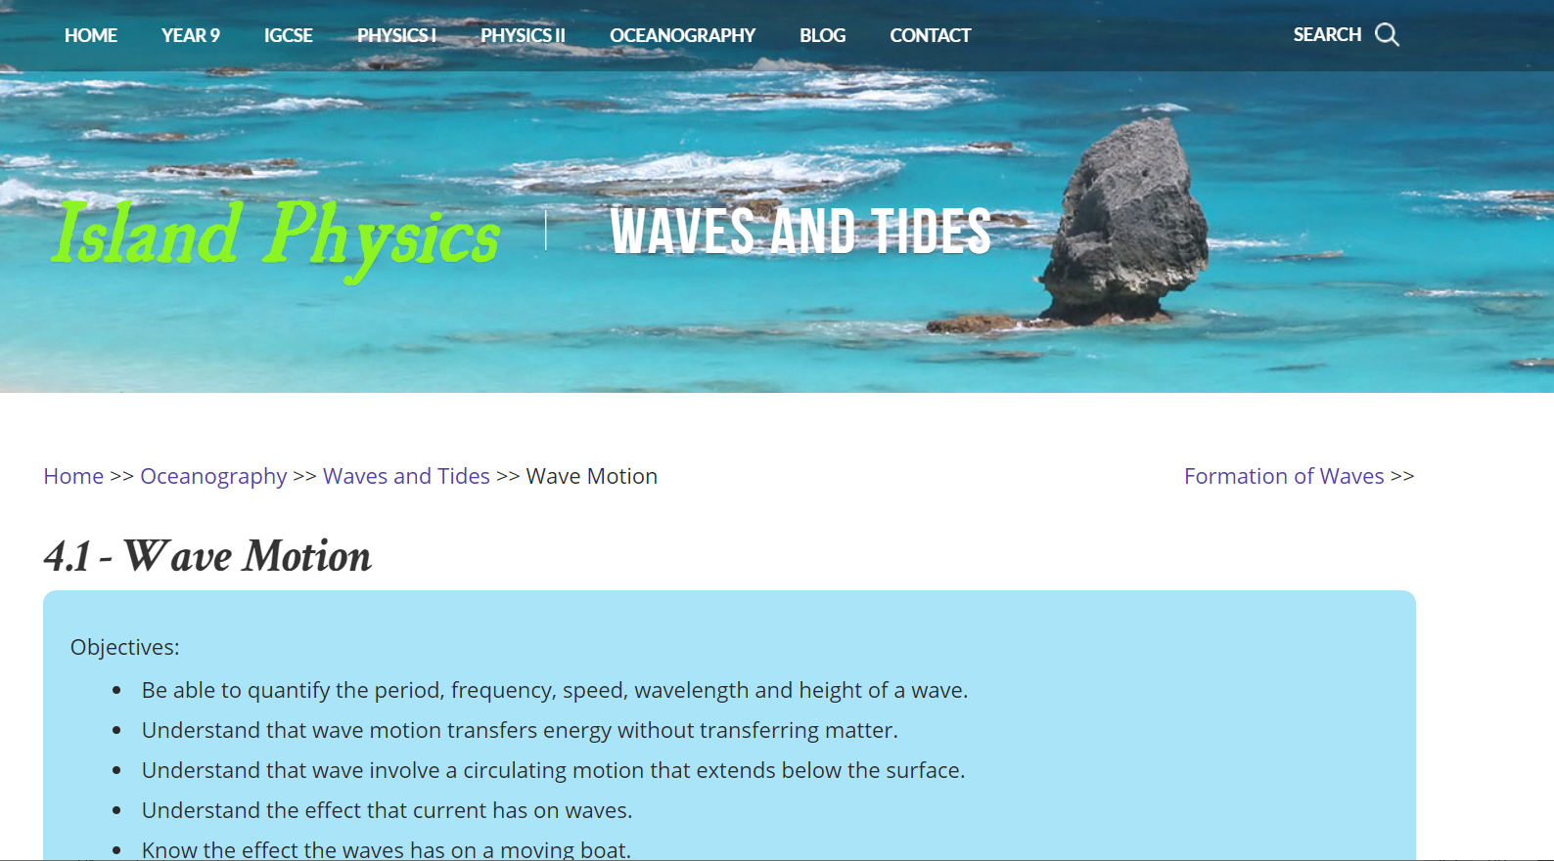
More Information and Links
Page 296 onwards

