Slide 1
Principles of Physics II
BERMUDA COLLEGE
1.1 – Density and Pressure

Slide 2
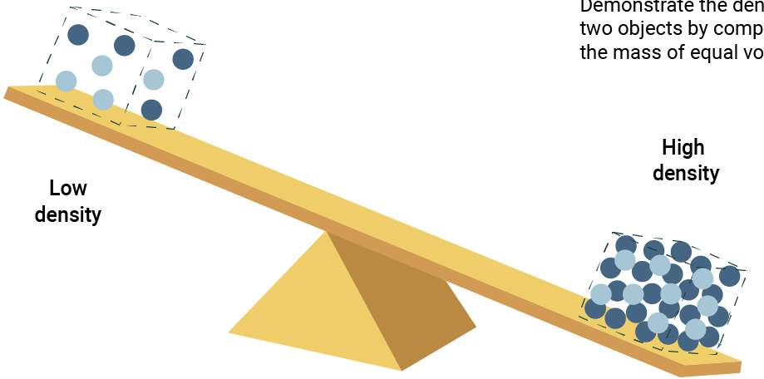
Density
How heavy something is for its size – i.e. its mass per unit volume.
Two factors affect the density of a material:
Molecular mass
How tightly packed the molecules are.

Slide 3
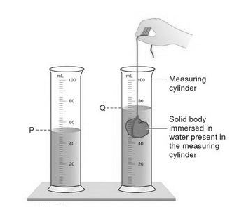
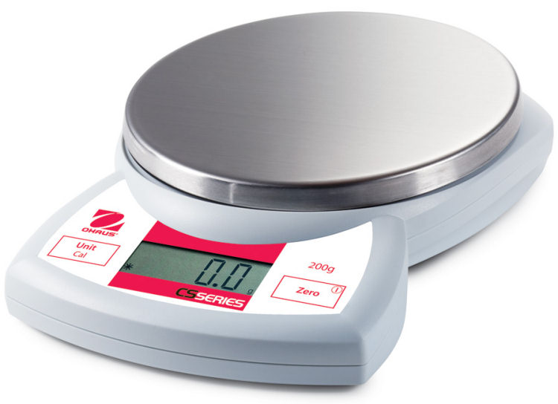
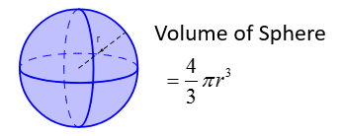
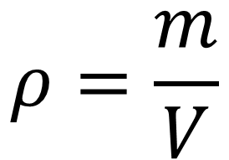
How to measure density in the lab
Use a scale or balance
$$ρ=\frac{m}{V}$$
If a liquid – use a measuring cylinder
If a gas – use volume of container
If an irregular shape – use water displacement
If a regular shape – use geometry

Slide 4
DEMO: Cut to webcam demo
Comparing masses of cubes
Measuring density

Slide 5
Densities of common substances
Material | Density (kg/m3) | Material | Density (kg/m3)
Gold | 19300 | Water | 1000
Copper | 8930 | Mercury | 13546
Iron | 7870 | Ethanol | 806
Steel | 7860 | Air | 1.3
Marble | 2600 | Carbon Dioxide | 1.98
Concrete | 2400 | Oxygen | 1.43
Wood (oak) | 650 | Hydrogen | 0.089
Densities of gases at 20 °C and atmospheric pressure.

Slide 6

What is Pressure?
Pressure is the effect of a force that acts on an area.
Ultimately every force acts on an area, but often it is not part of the problem involved. Common examples are found in everyday life where the area is minimized or maximized to reduce or increase the pressure.
$$P= \frac{F}{A}$$
Confusingly, there are lots of units to choose from!
Modern: N/m2 (also known as Pascals), N/cm2, mmHg, Bar, atm
Old: psi (lb/in2), inHg,

Slide 7
Some examples of pressure

Slide 8
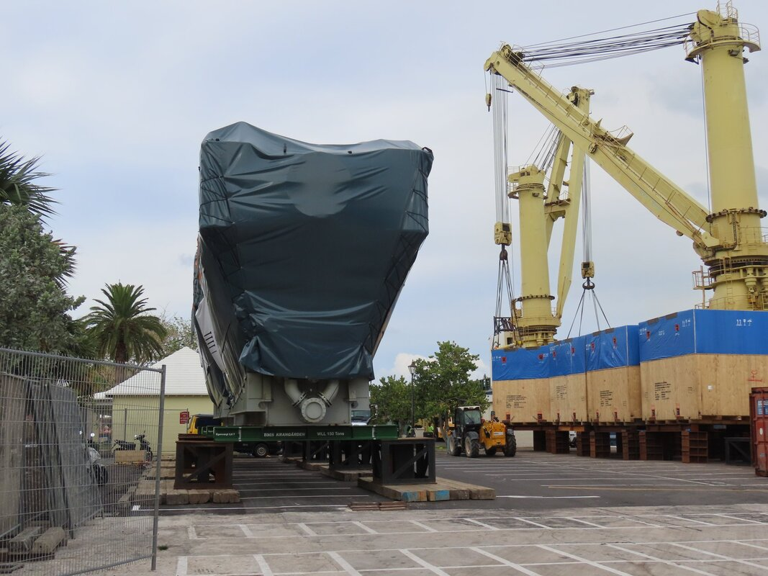
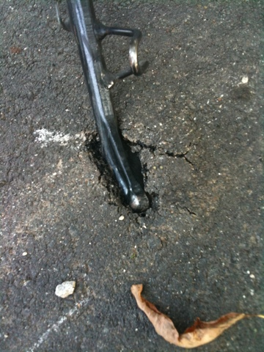
BELCO new engine and motorbike stands!
Wooden blocks to spread the load so that the engine does not sink into the tarmac.
The stand of a MUCH lighter bike has sunk into the same type of tarmac. Why?

Slide 9
DEMO: Cut to webcam
Demonstrating high and low pressures
Blu tac and knife
Washer and bolt

Slide 10
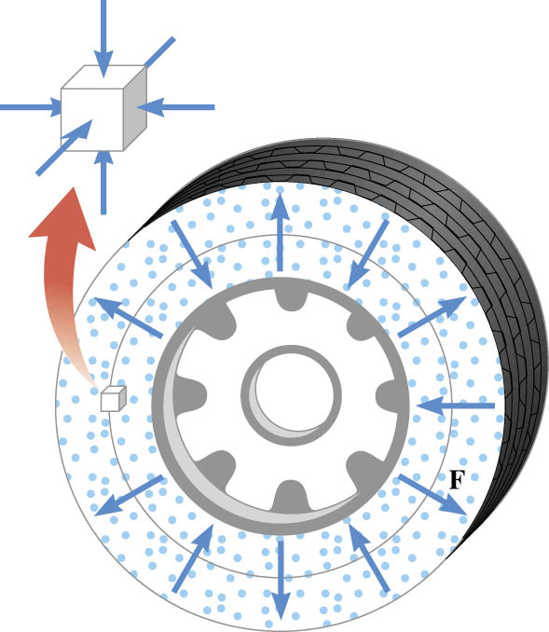
Pressure due to gases

Slide 11
Examples
Air has a density of $1.29 \text{kg}\text{/}{\text{m}}^{3}$under standard conditions. What is the mass of air in a room with dimensions $10 \text{m} ×8 \text{m}×3 \text{m}$?

Slide 12
$80 \text{mL}$ of ethanol has a mass of $63.3 \text{g}$. What is its density?

Slide 13
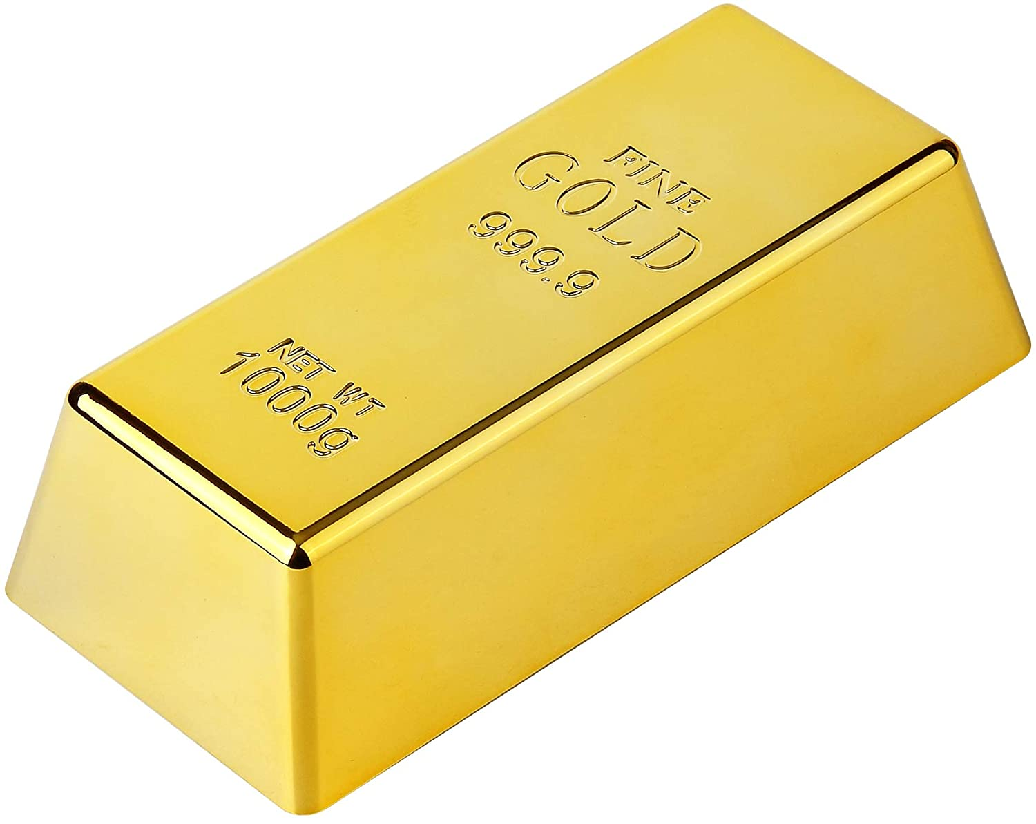
A bar of gold measures 0.15 m x 0.050 m x 0.050 m. How many gallons of water have the same mass as this bar? 1 gal = 3.785 × 10^{–3} m³

Slide 14
A solid concrete block weighs 169 N and is resting on the ground. Its dimensions are 0.400 m x 0.200 m x 0.100 m. What is the smallest number of whole blocks that can be stacked so that their weight creates a pressure of at least two atmospheres on the ground beneath the first block?

